Slide 1
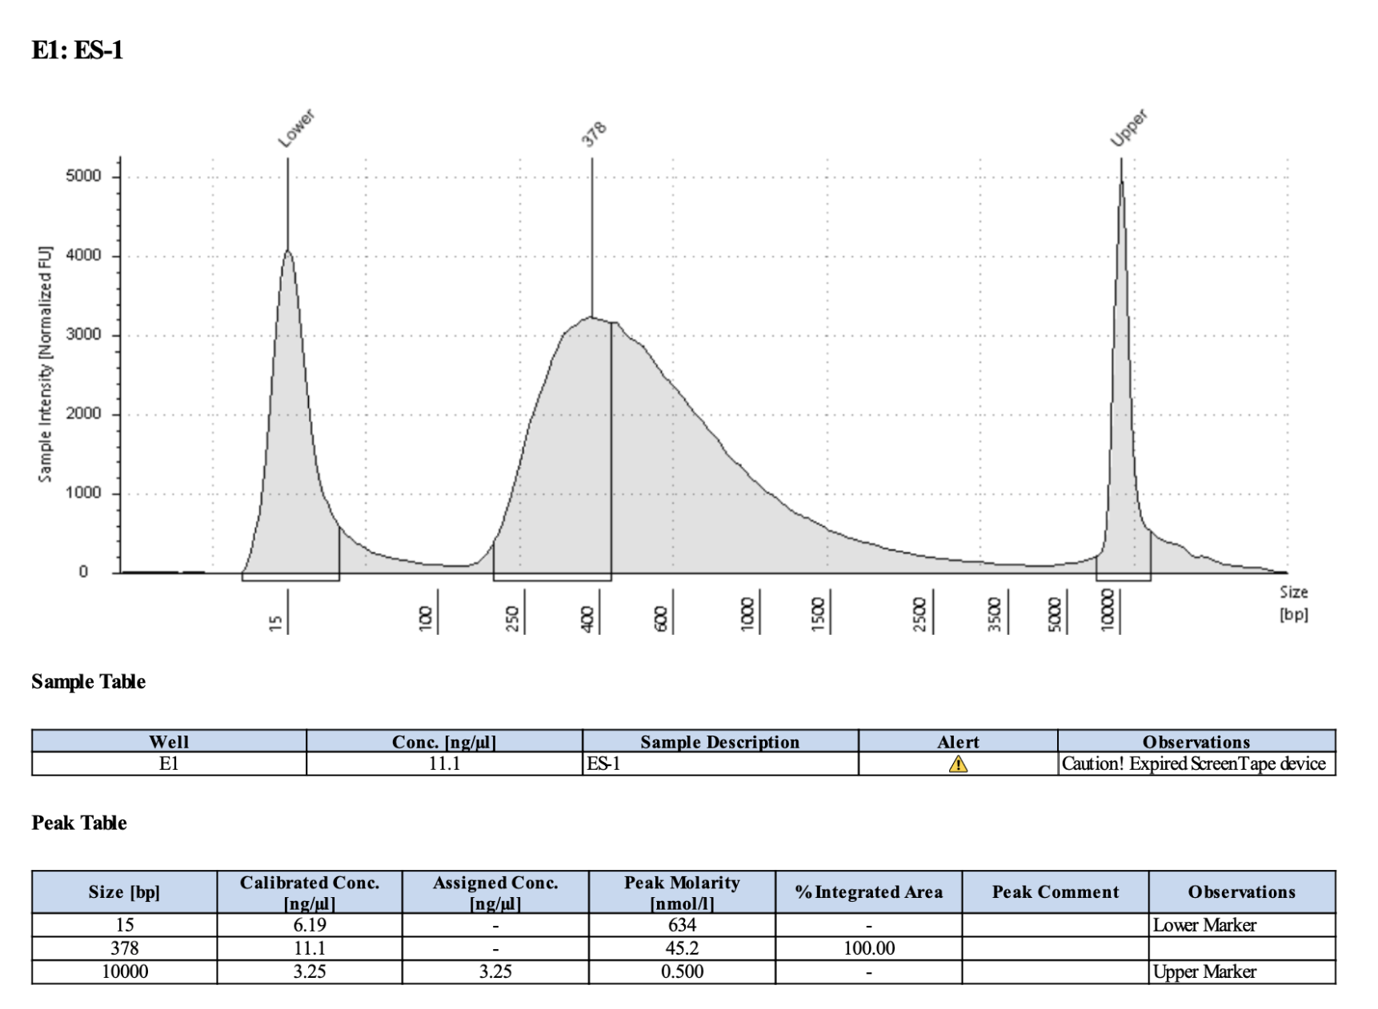
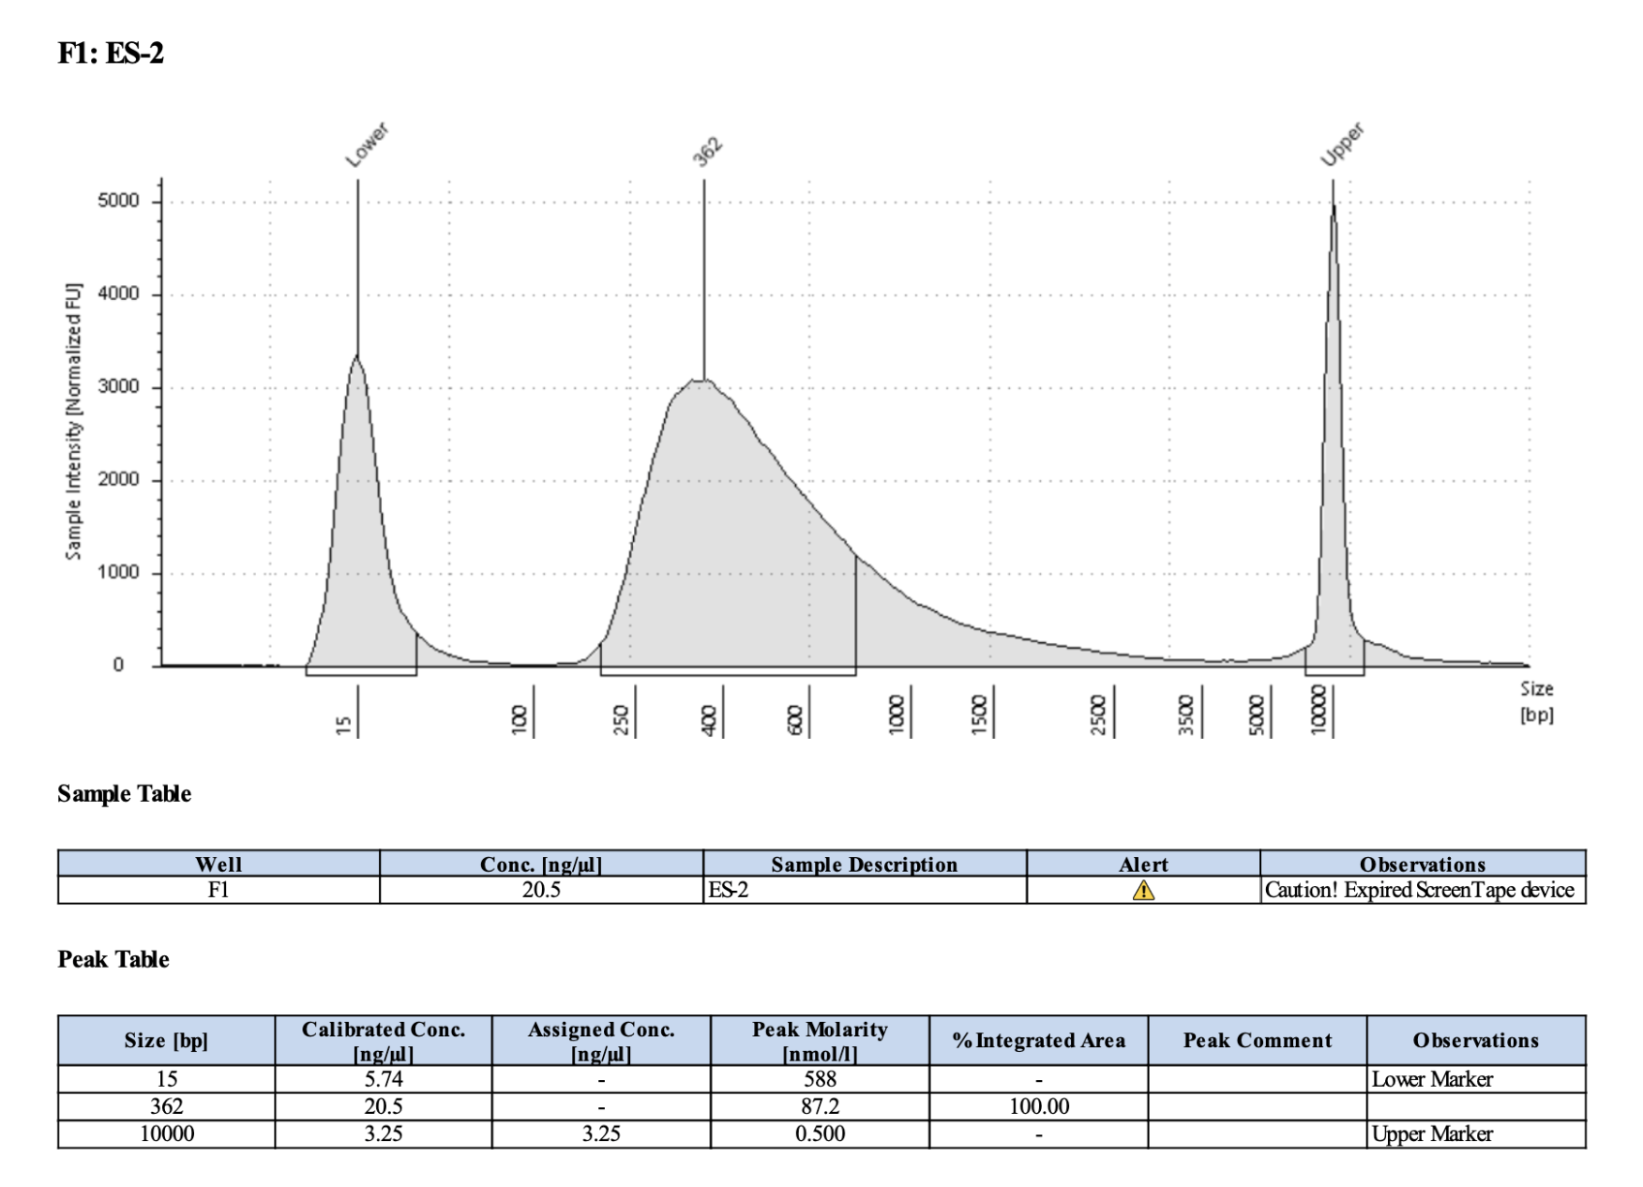
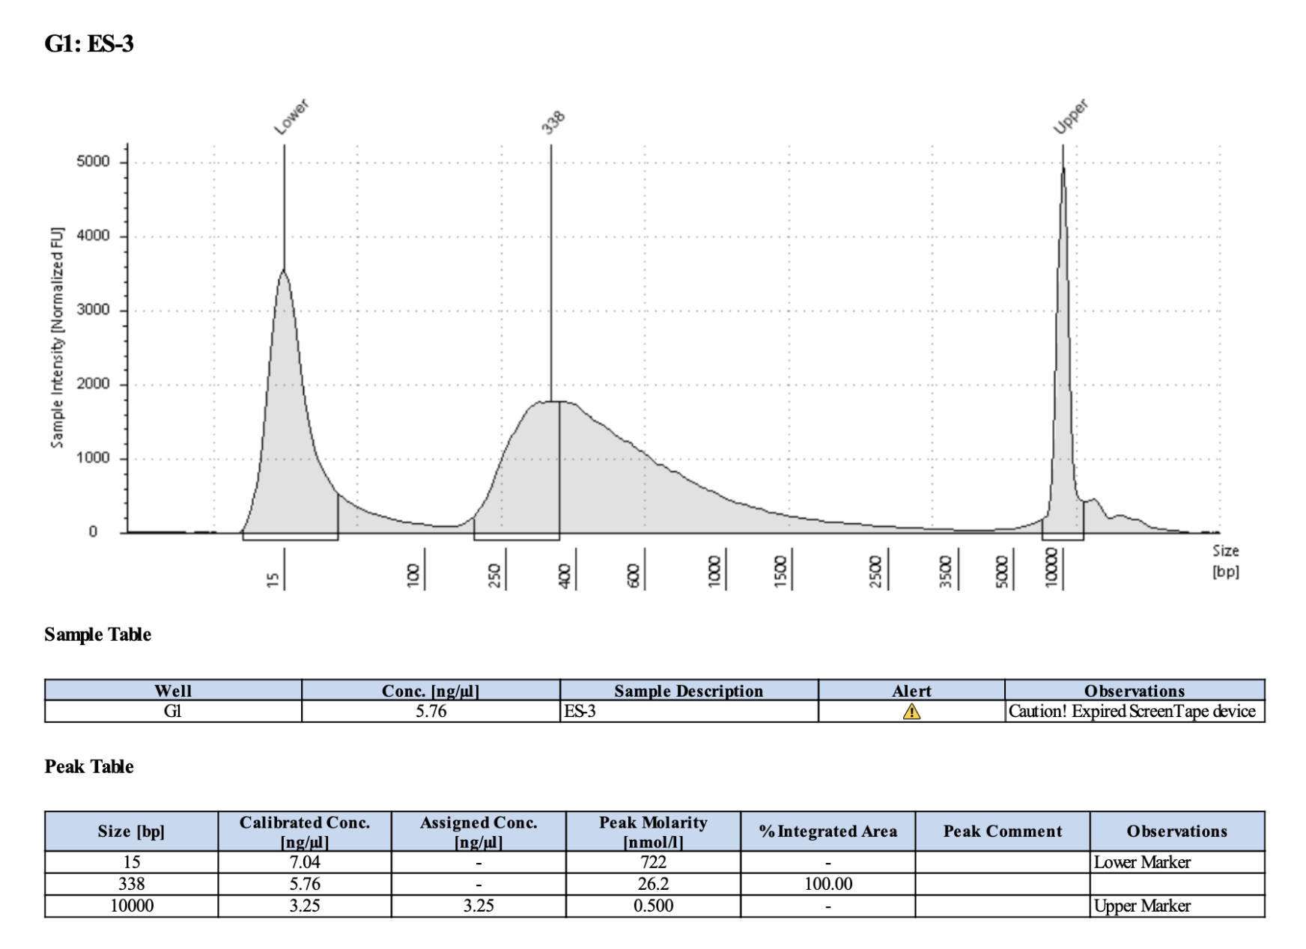
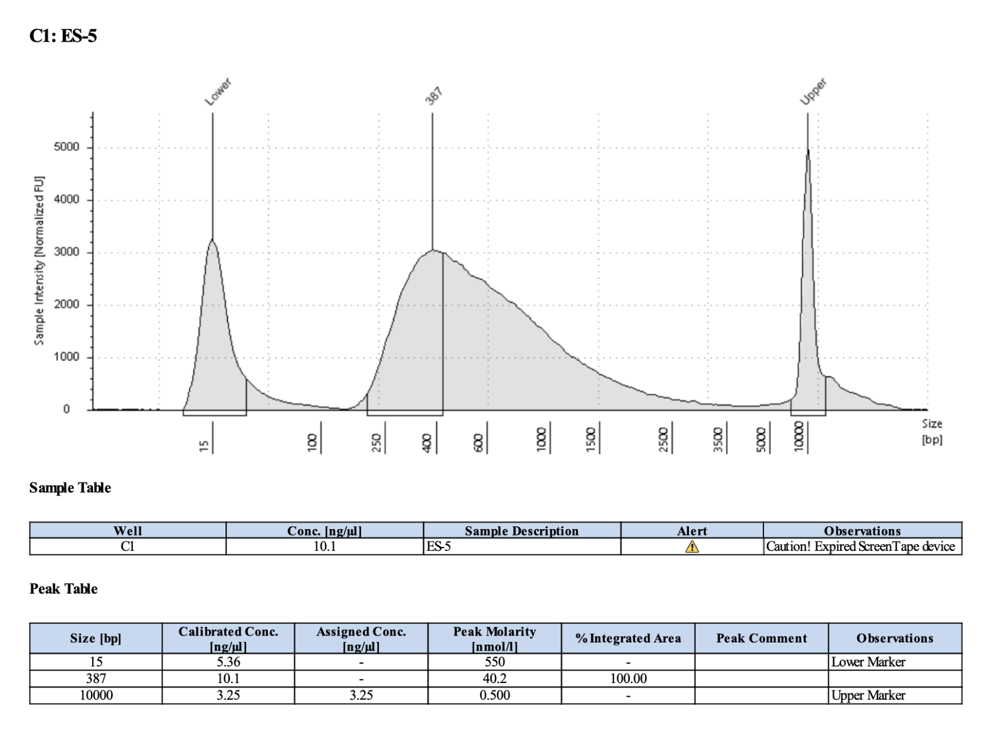
Index #1; Pico #1; 1296
Index #2; Pico #2; 2197
378
362
Index #3; Pico #3; 1225
Index #5; Pico #5; 2413
338
387

Slide 2
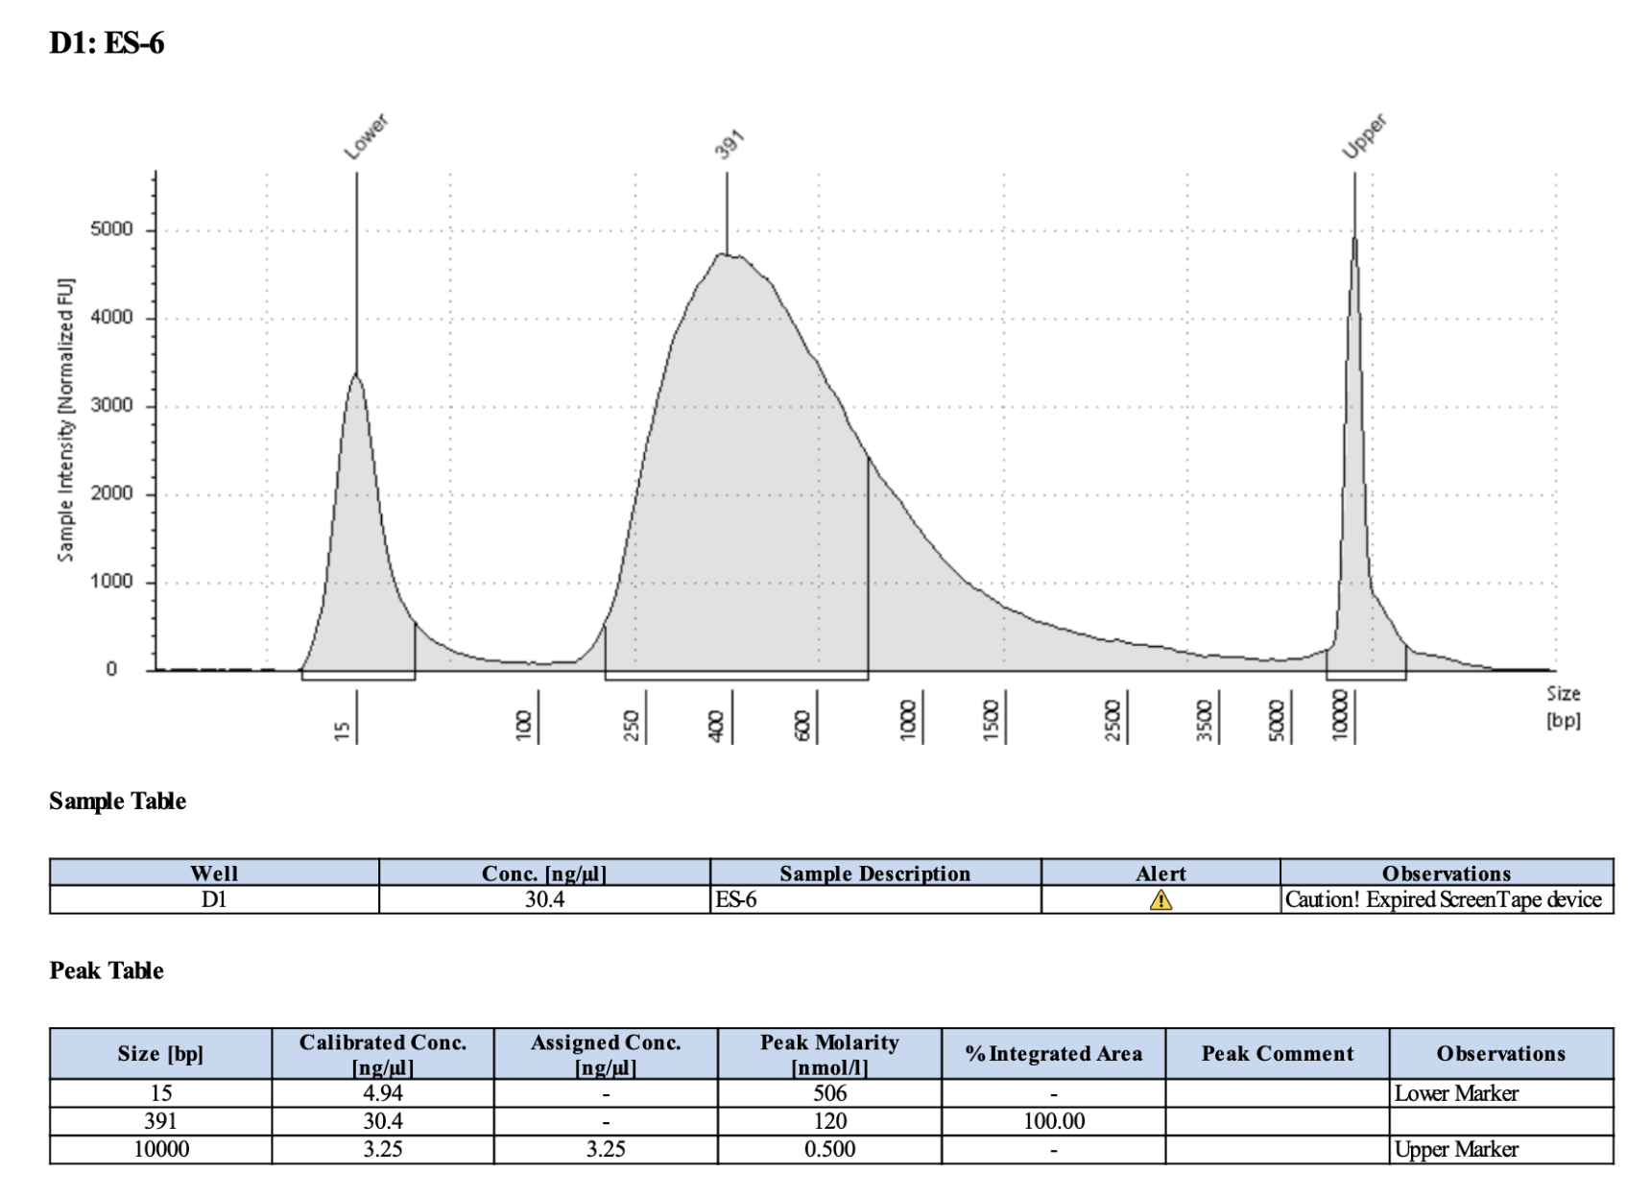
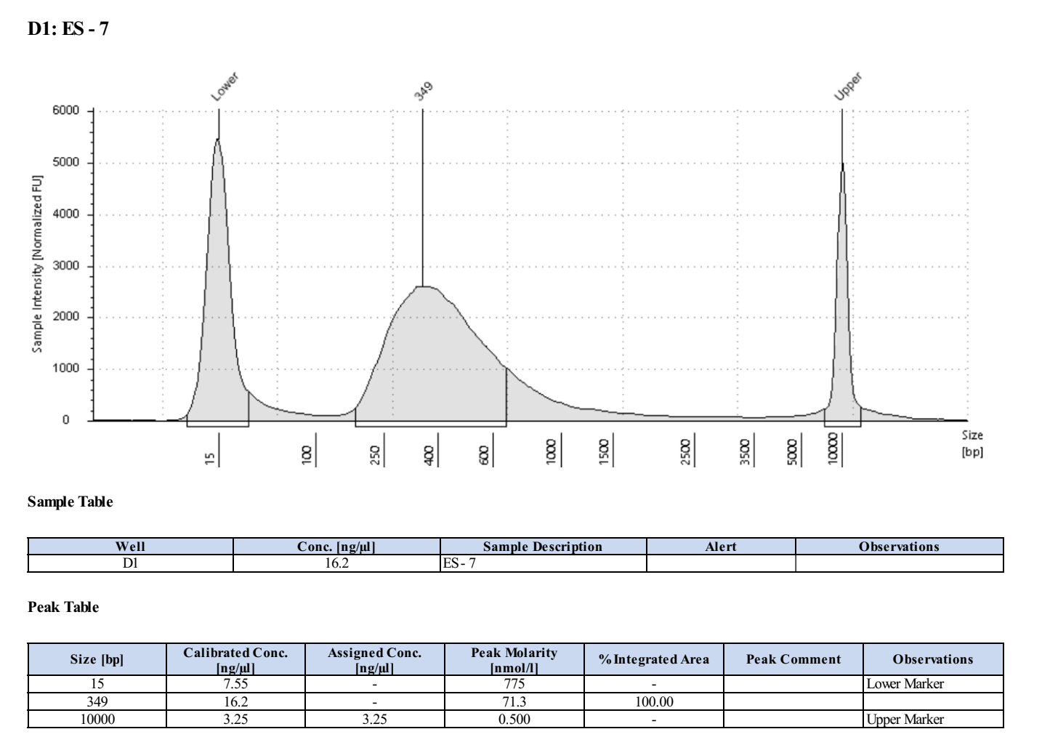
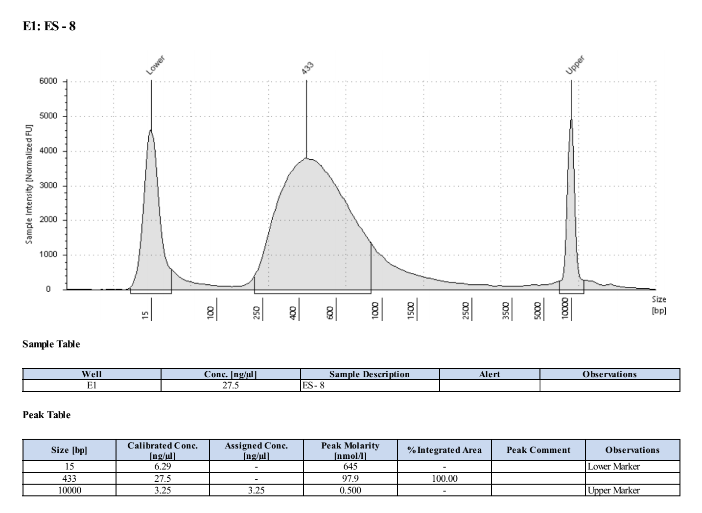
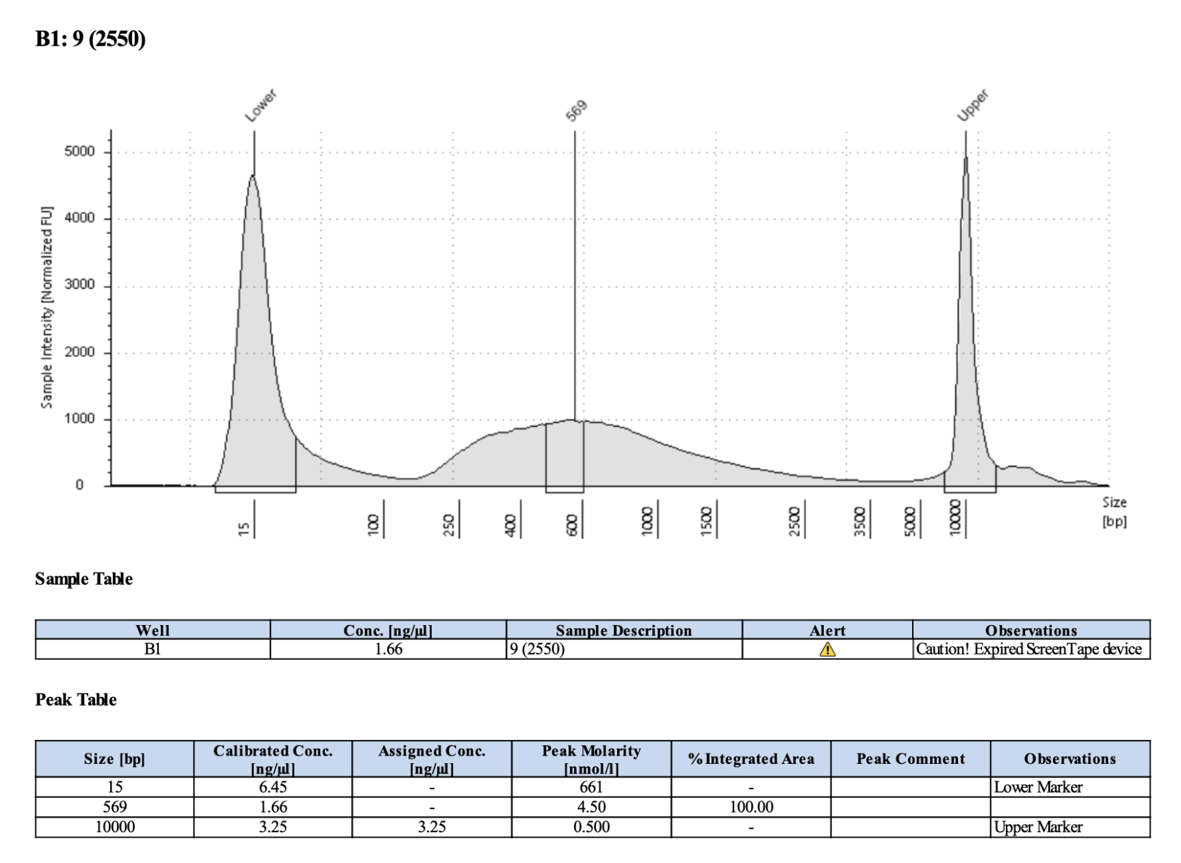
Index #6; Pico #6; 1445
Index #7; Pico #7; 1707
391
349
Index #8; Pico #8; 2212
Index #9; Pico #9; 2550
433
569

Slide 3
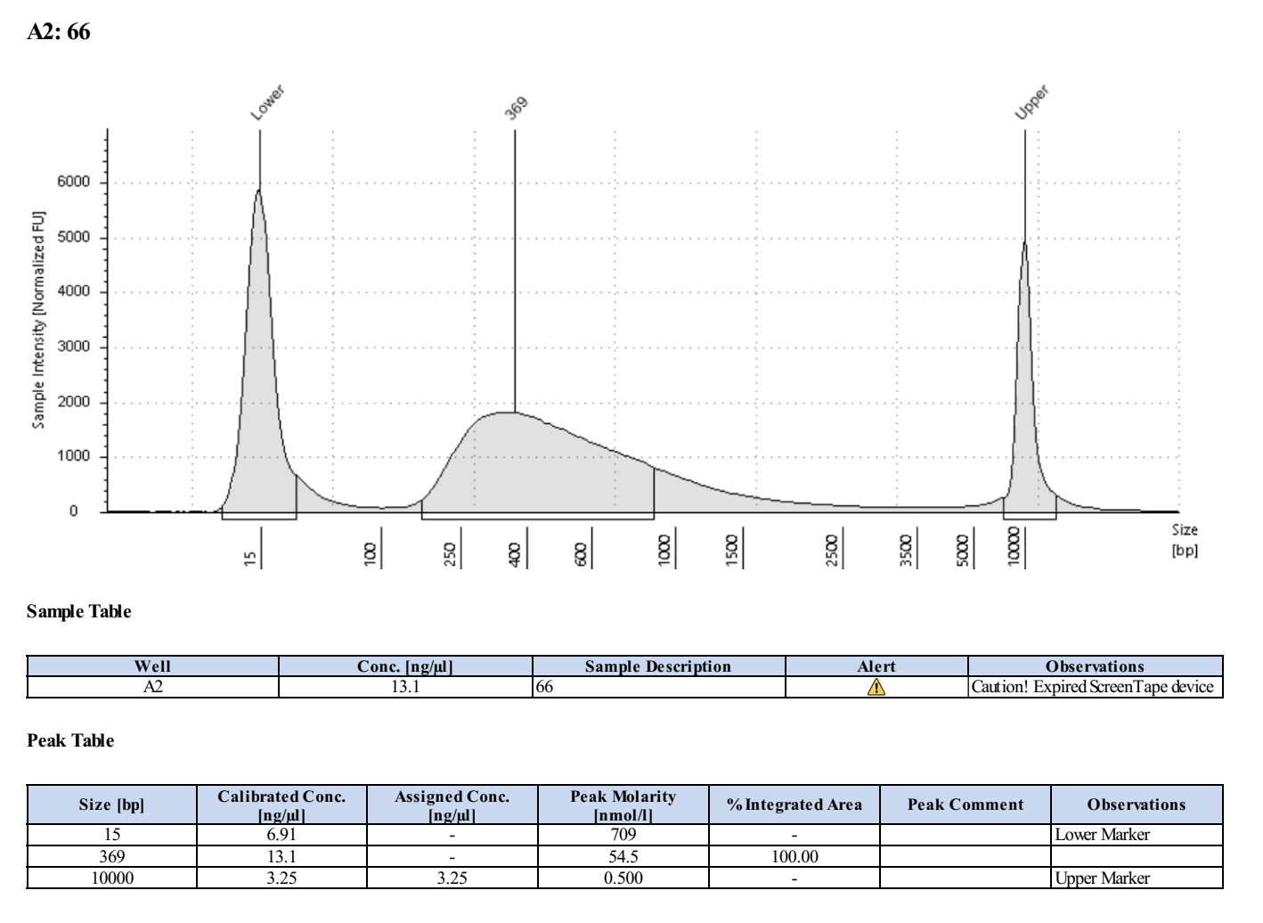
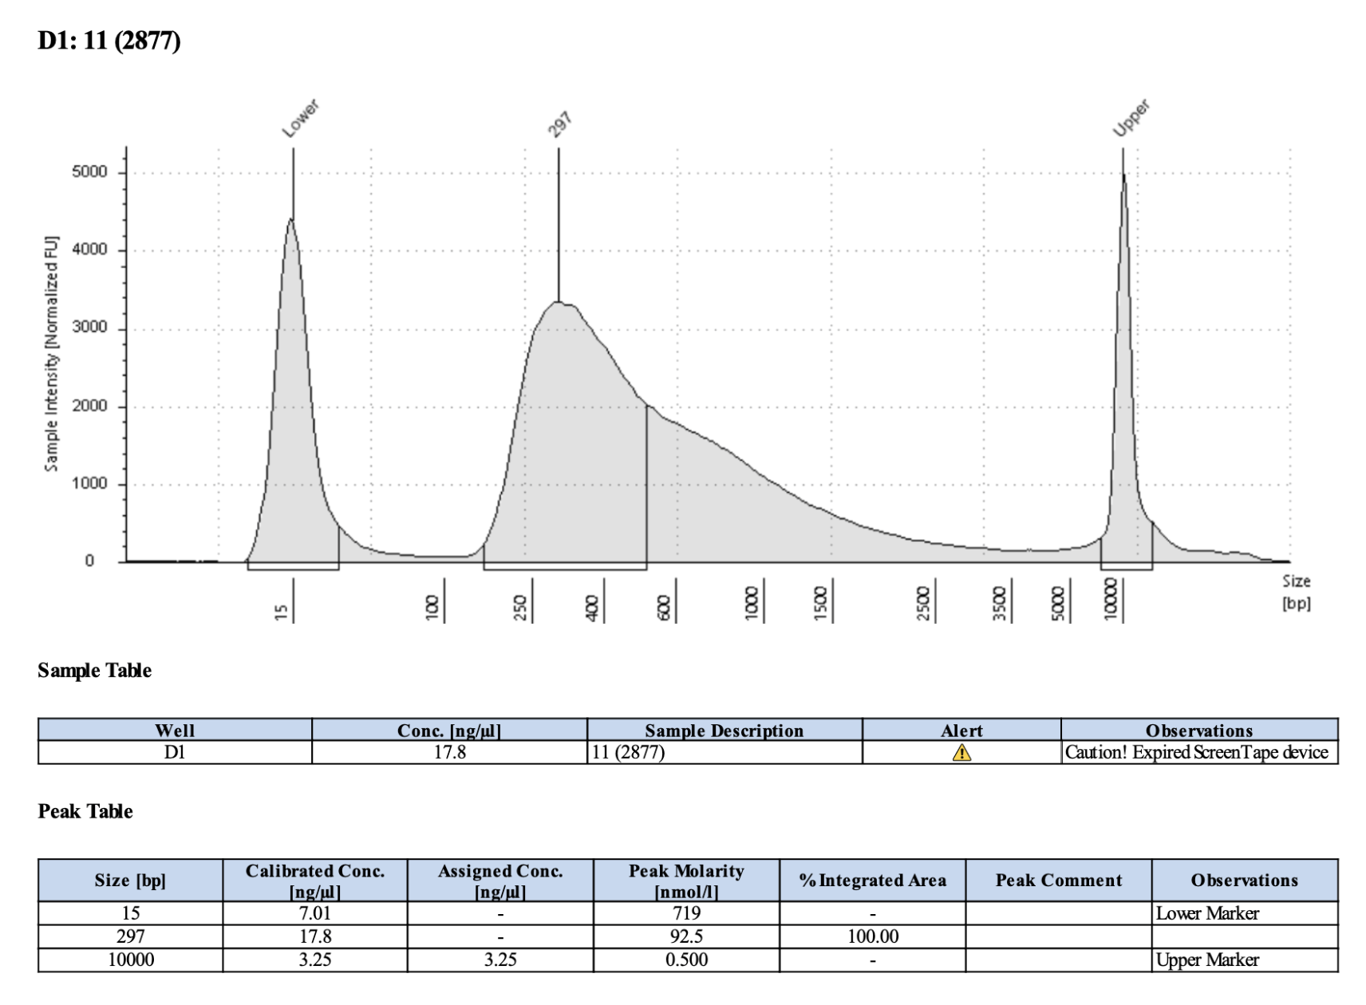
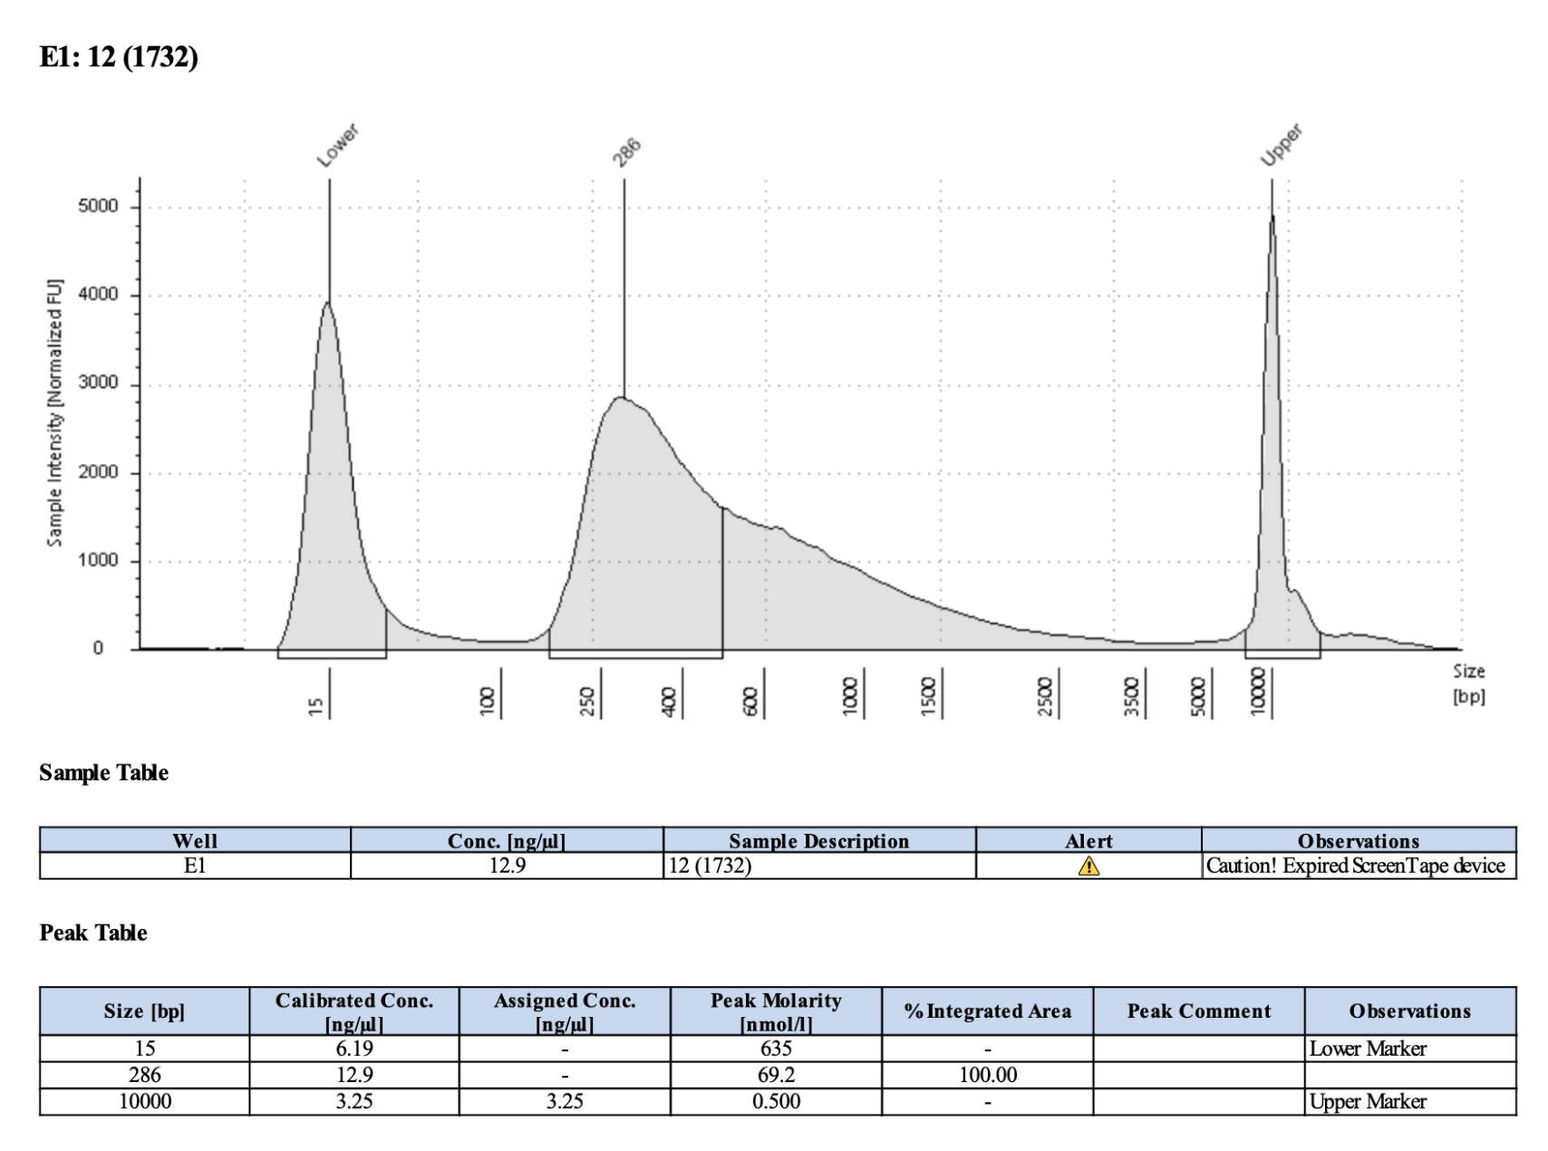
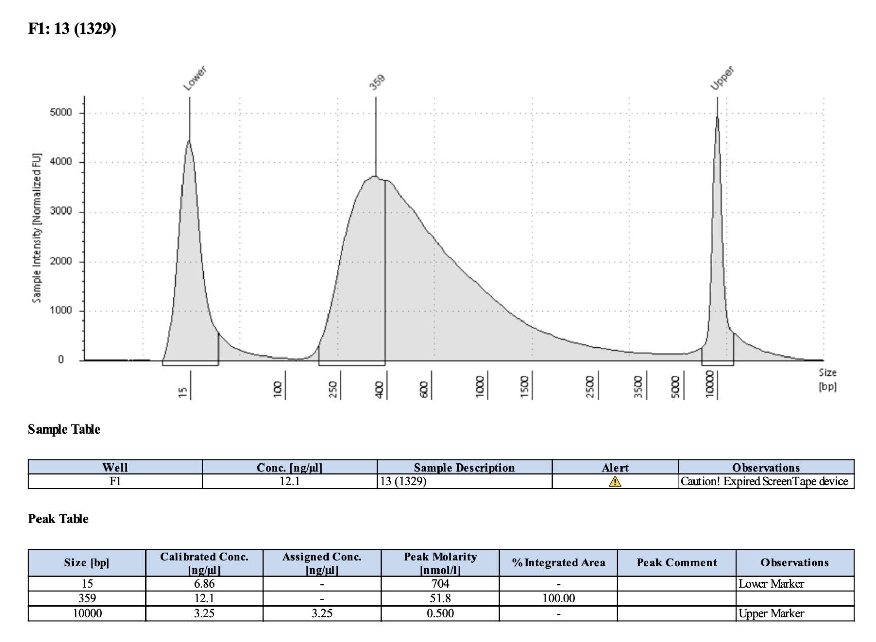
Index #10; Pico #66; 2861
Index #11; Pico #11; 2877
369
297
Index #12; Pico #12; 1732
Index #13; Pico #13; 1329
286
359

Slide 4
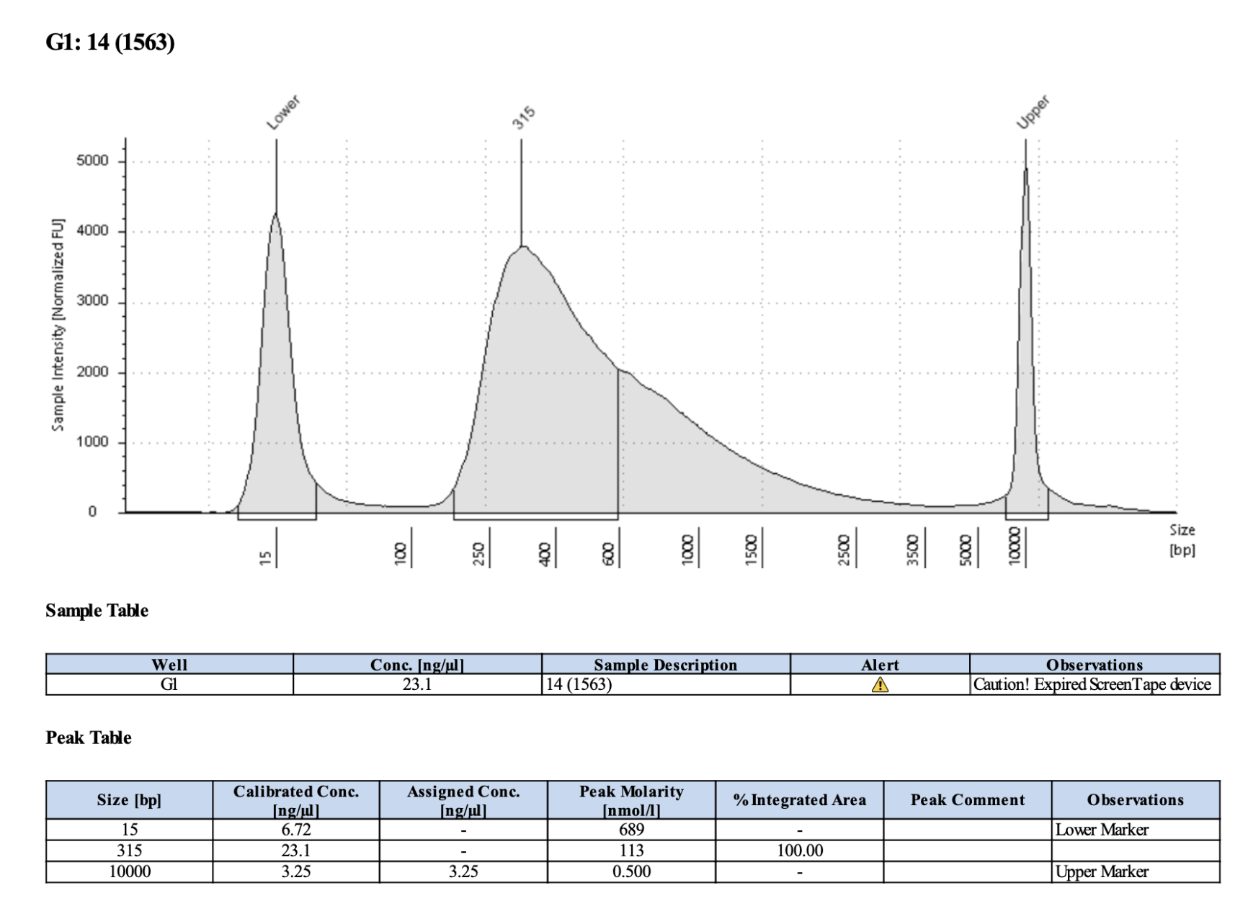
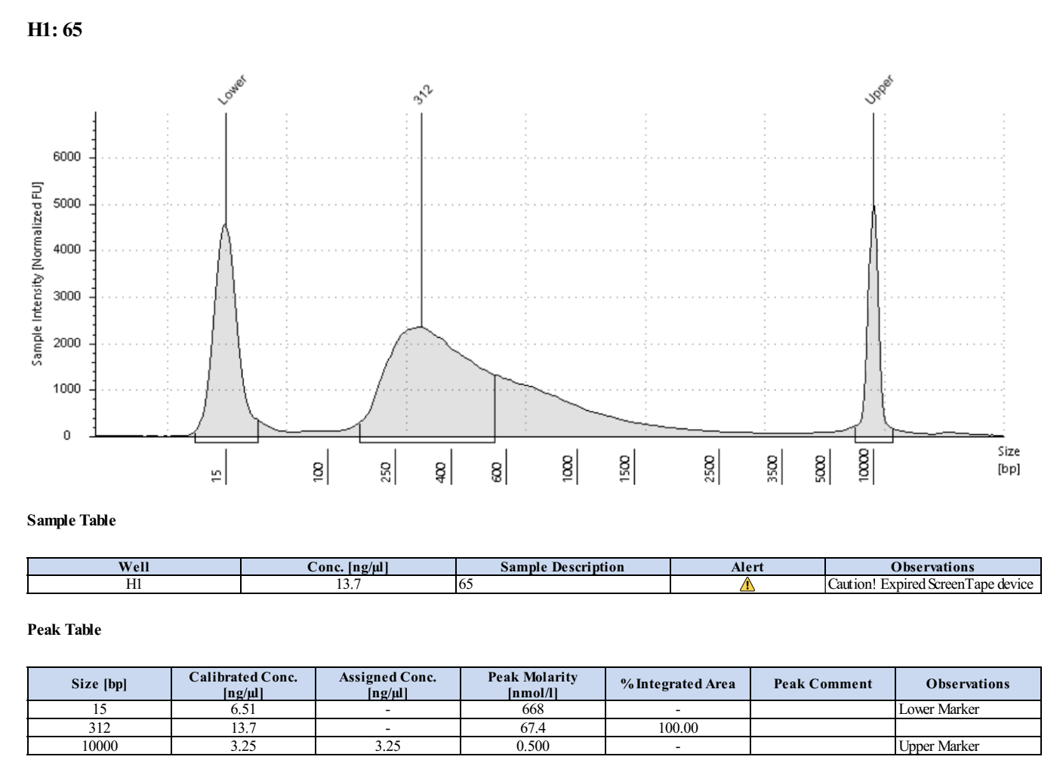
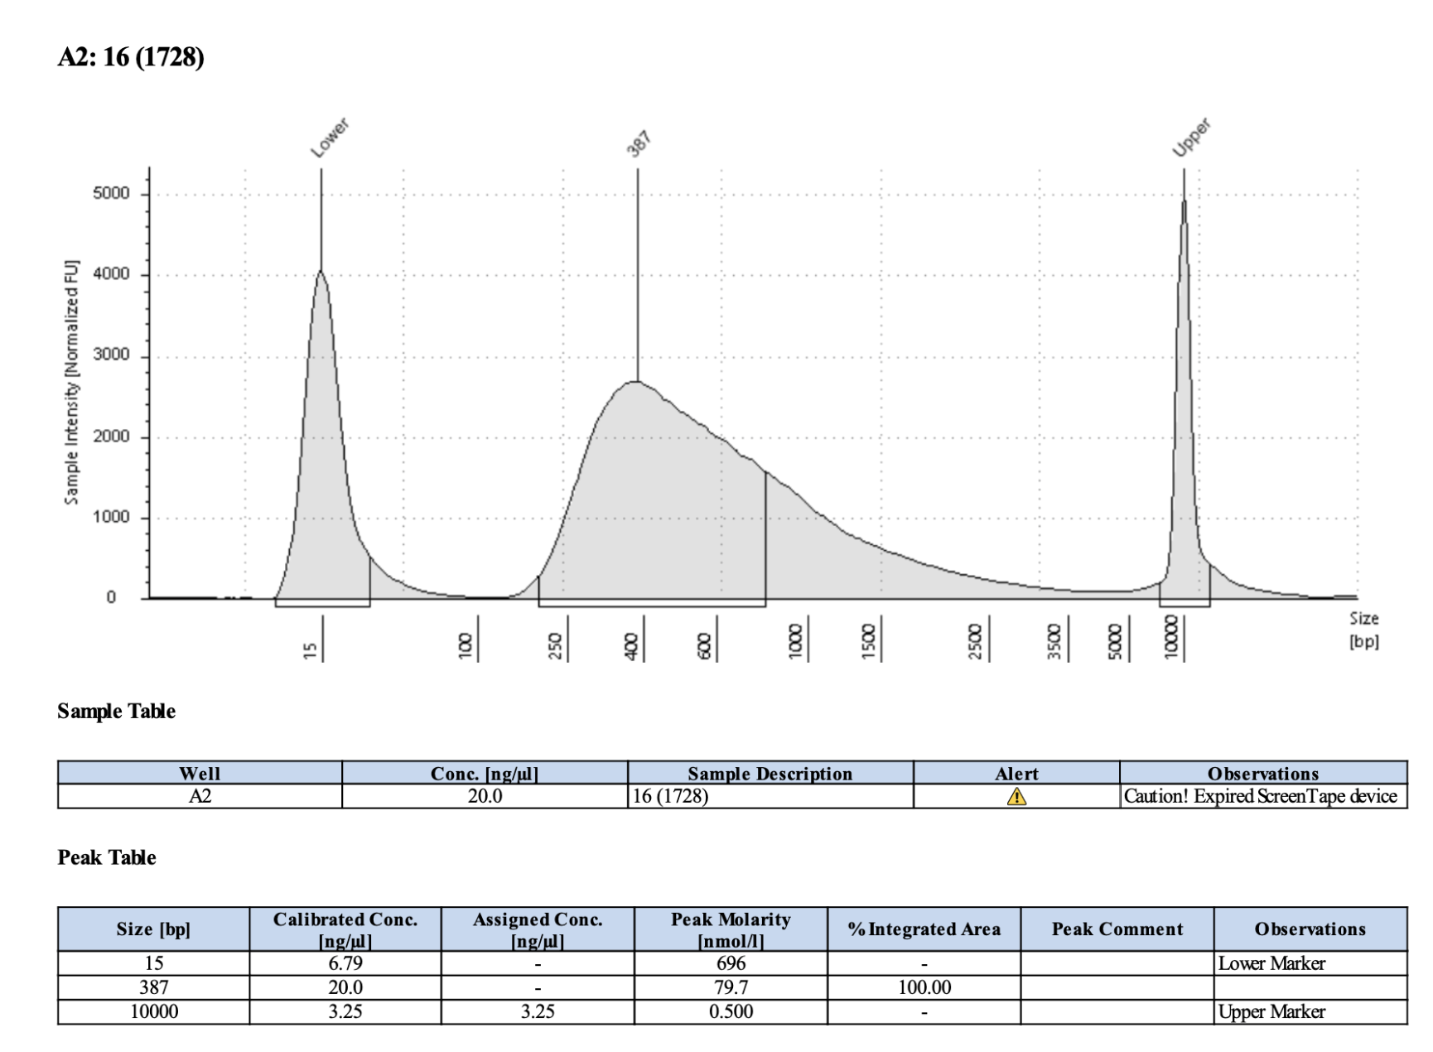
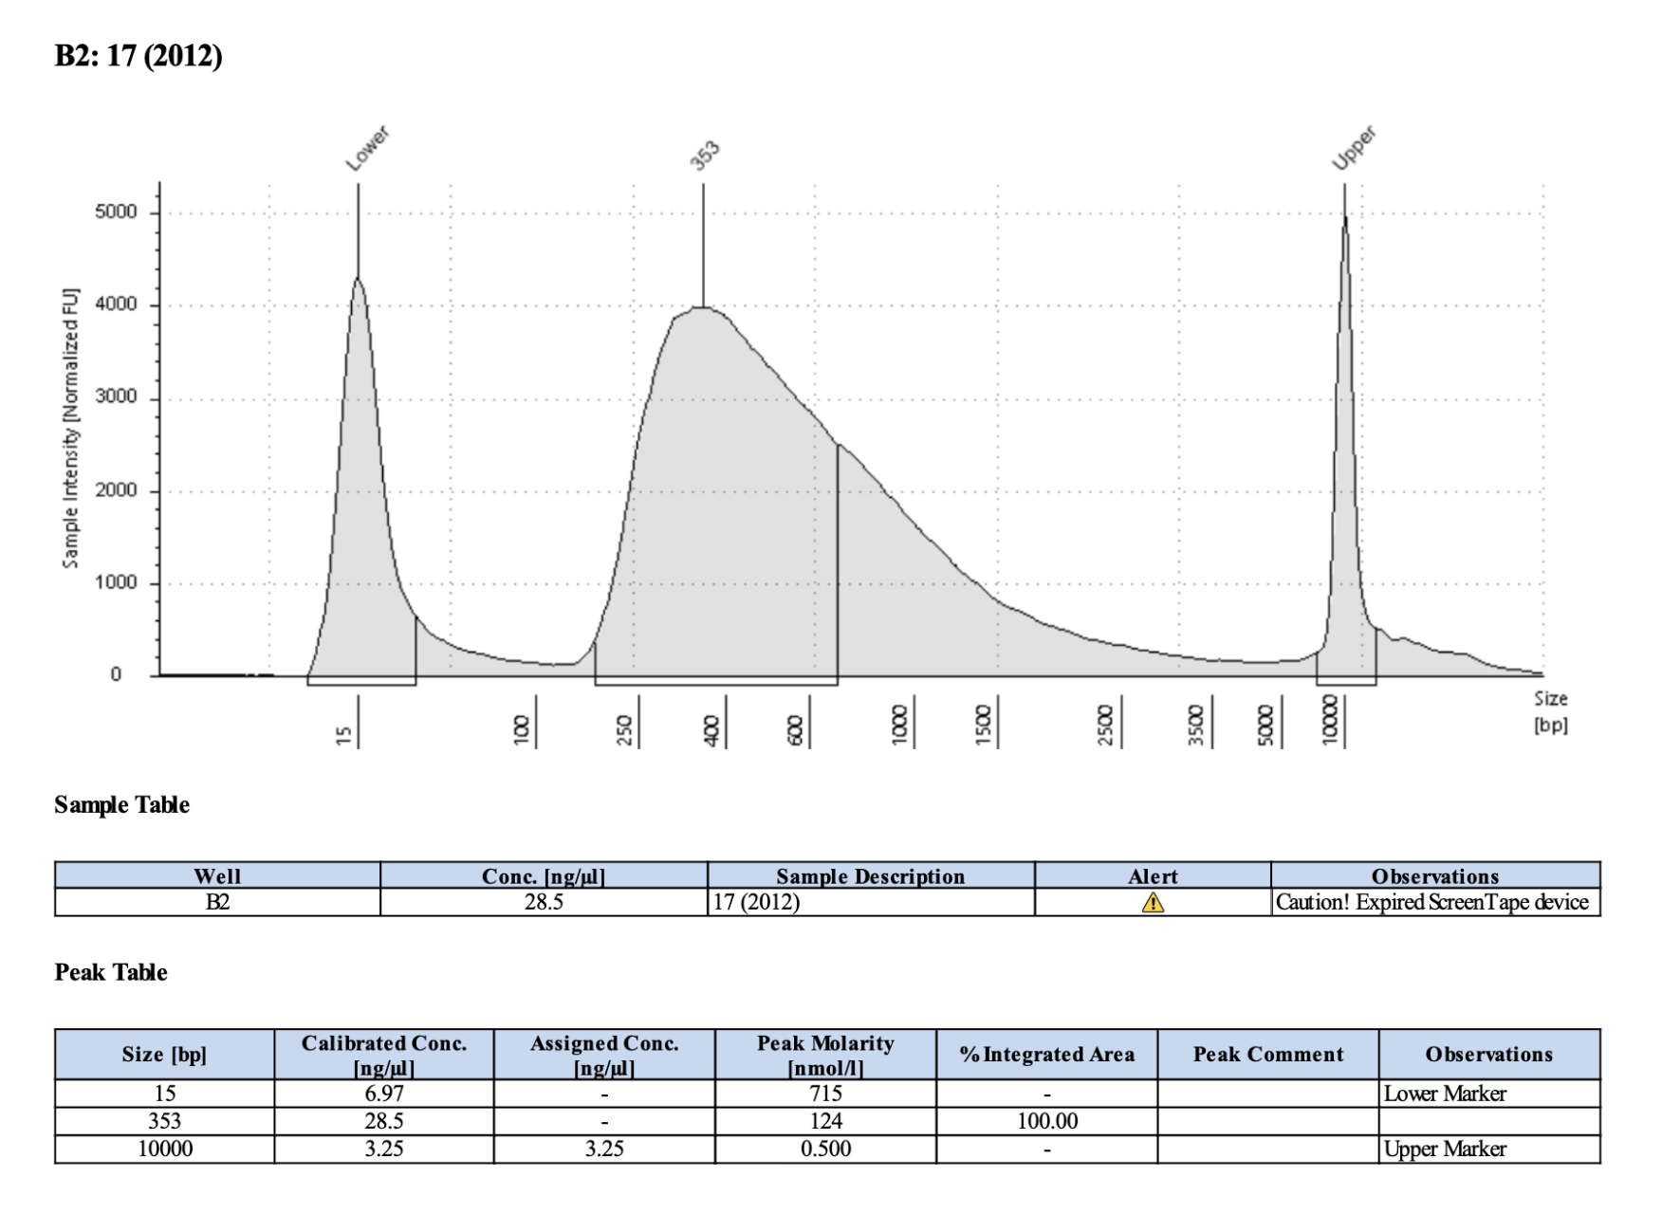
Index #14; Pico #14; 1563
Index #15; Pico #65; 1103
315
312
Index #16; Pico #16; 1728
Index #17; Pico #17; 2012
387
353

Slide 5
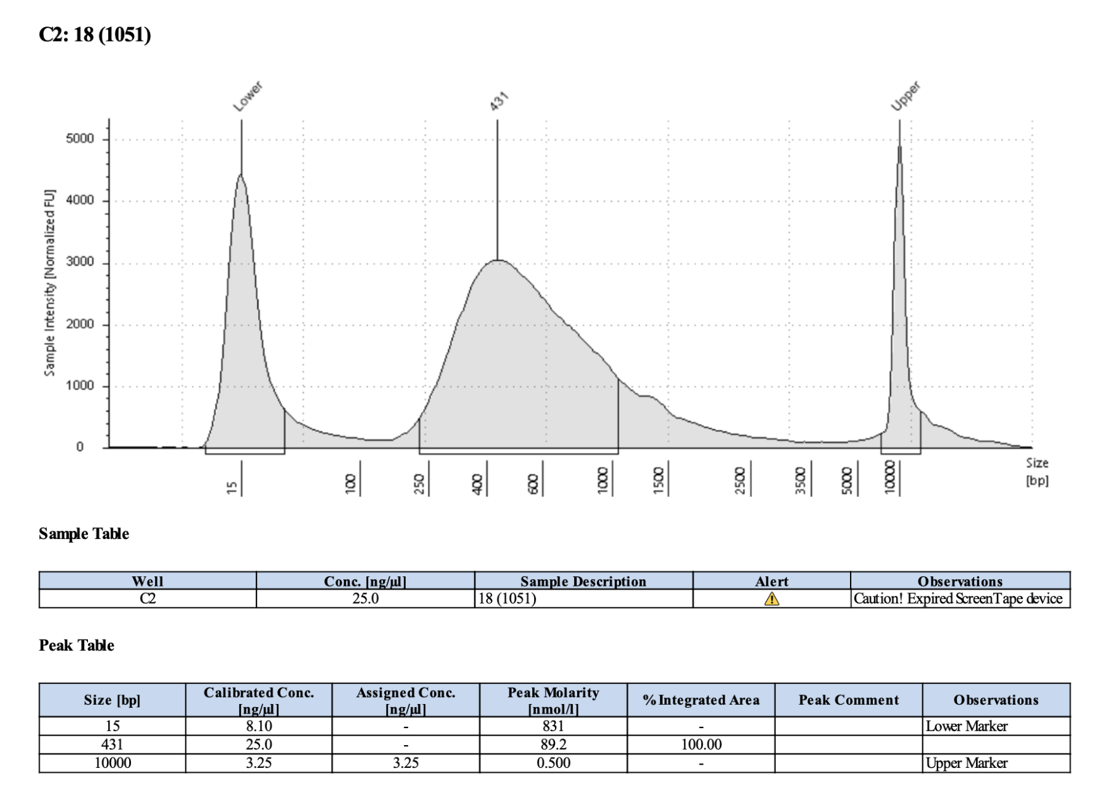
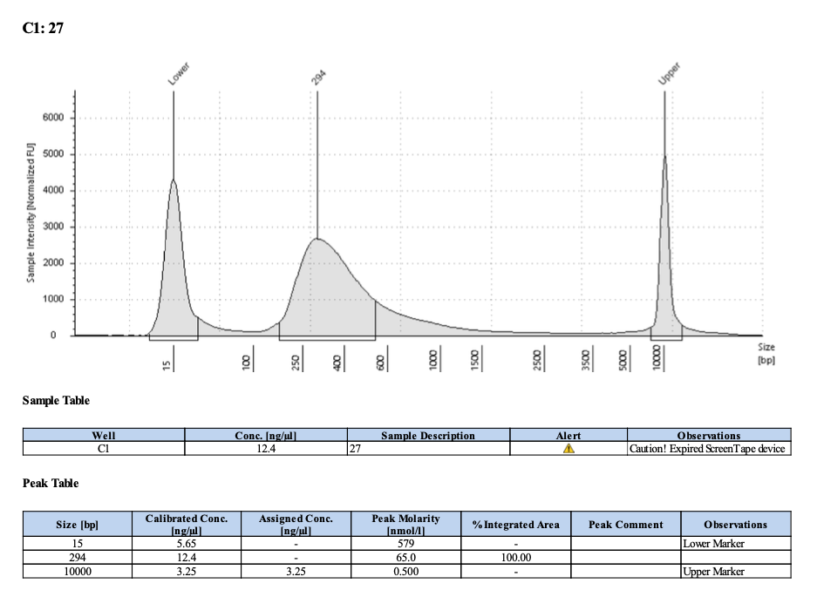
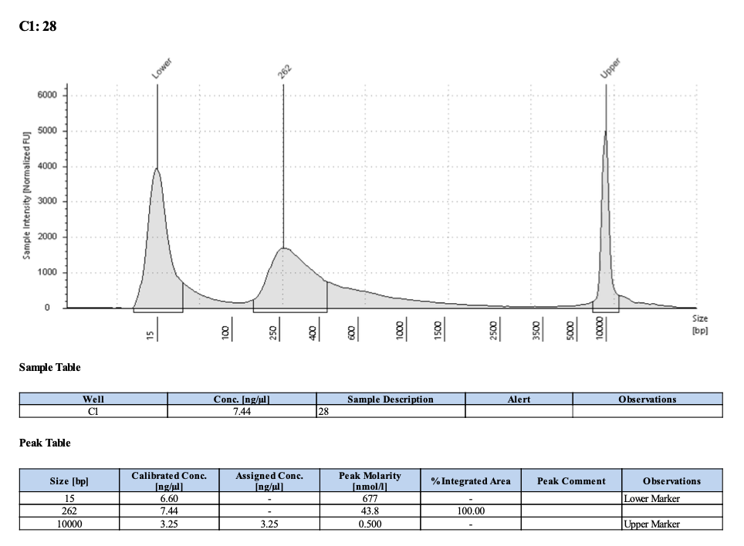
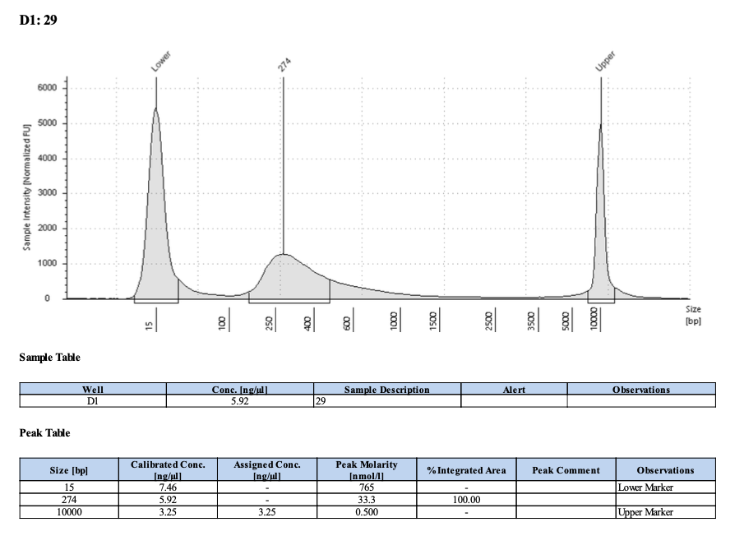
Index #18; Pico #18; 1051
Index #19; Pico #27; 1559
431
294
Index #20; Pico #28; 2513
Index #21; Pico #29; 1820
262
274

Slide 6
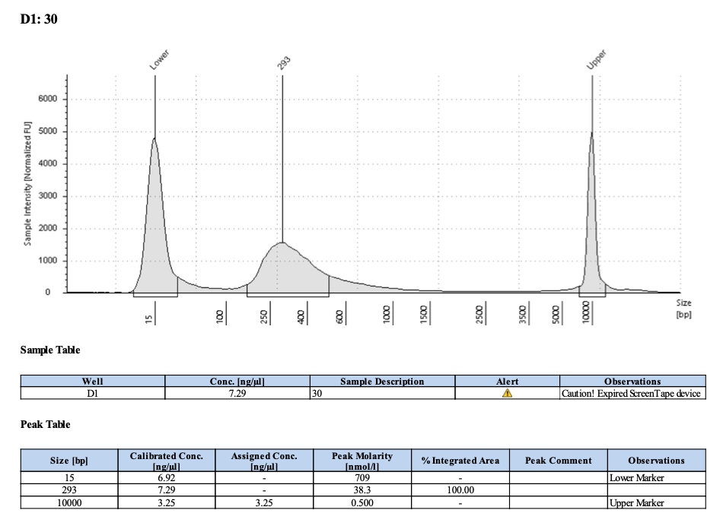
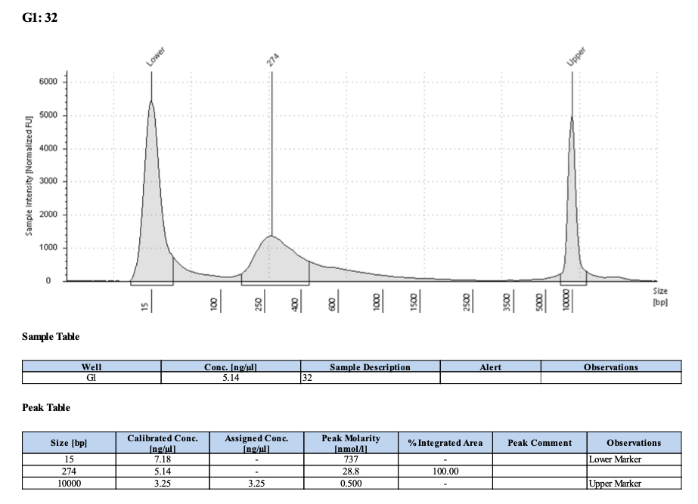
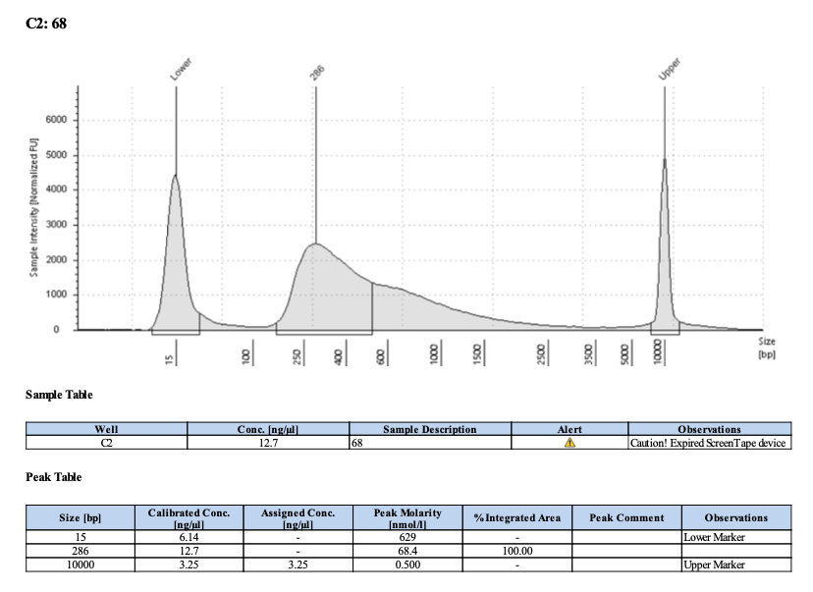
Index #22; Pico #30; 1238
Index #23; Pico #; 2064
293
Index #24; Pico #32; 1168
Index #25; Pico #68; 1459
274
286

Slide 7
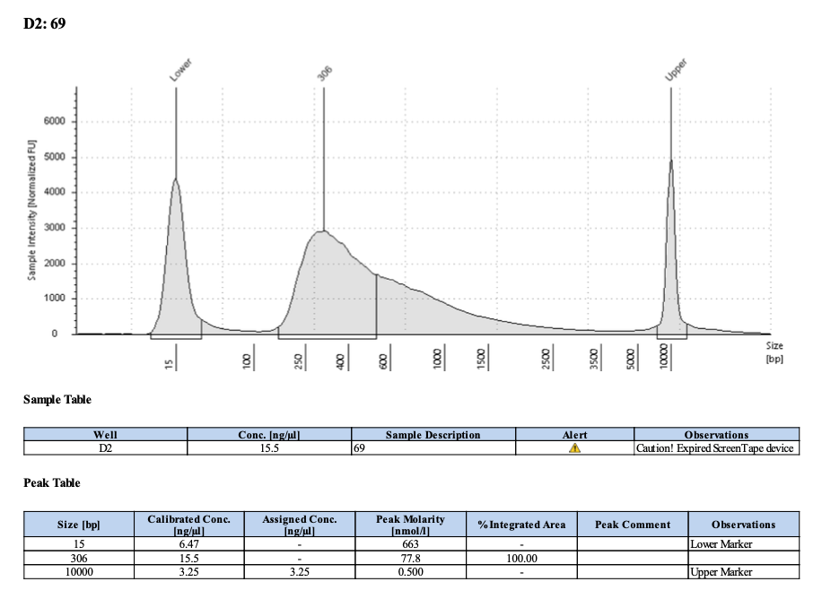
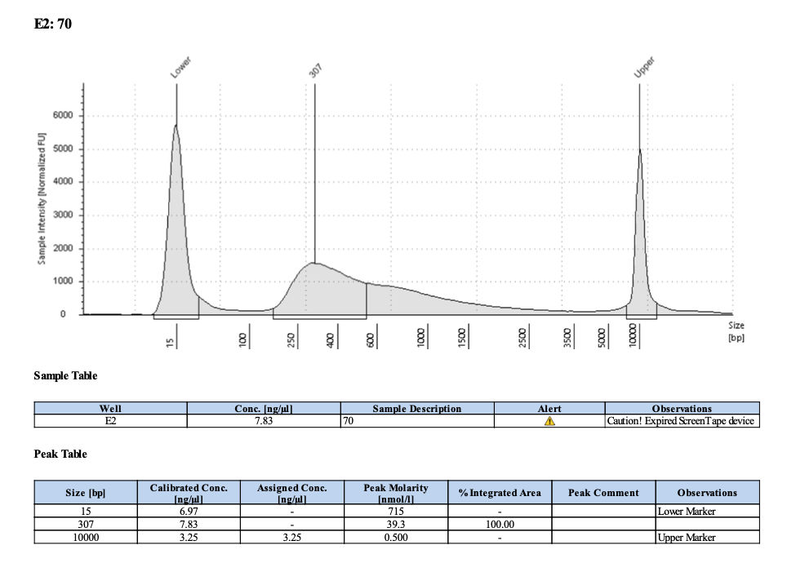
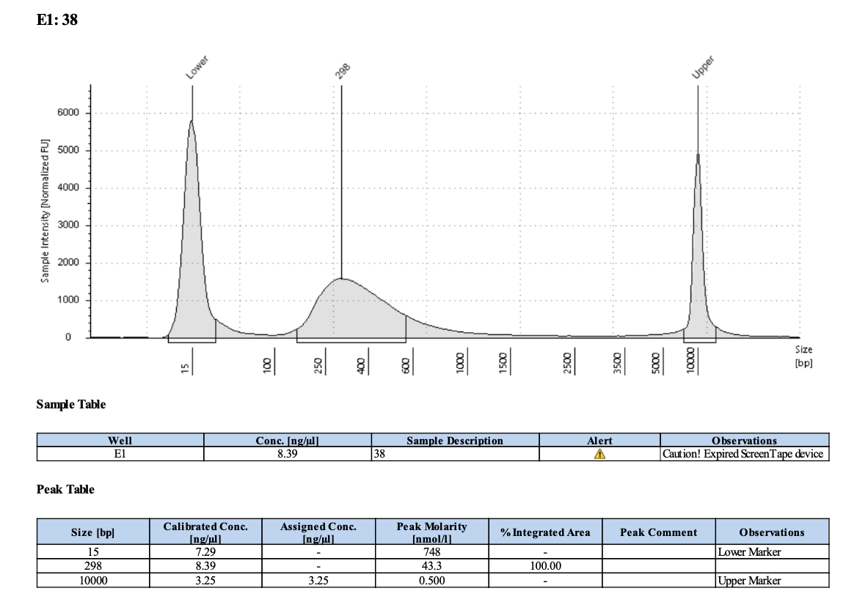
Index #26; Pico #69; 1765
Index #27; Pico #70; 2072
306
307
Index #28; Pico #38; 2304
Index #29; Pico #; 1184
298

Slide 8
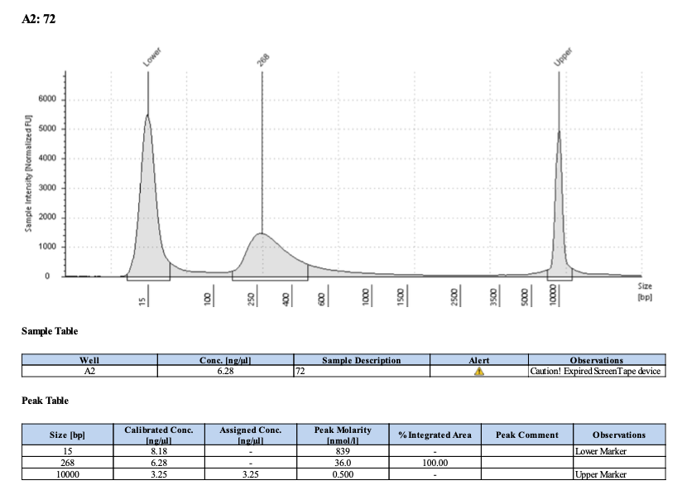
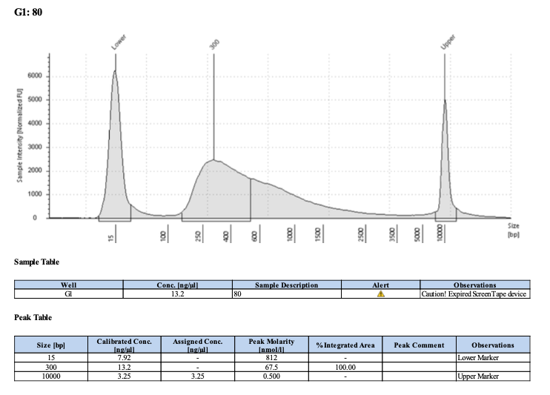
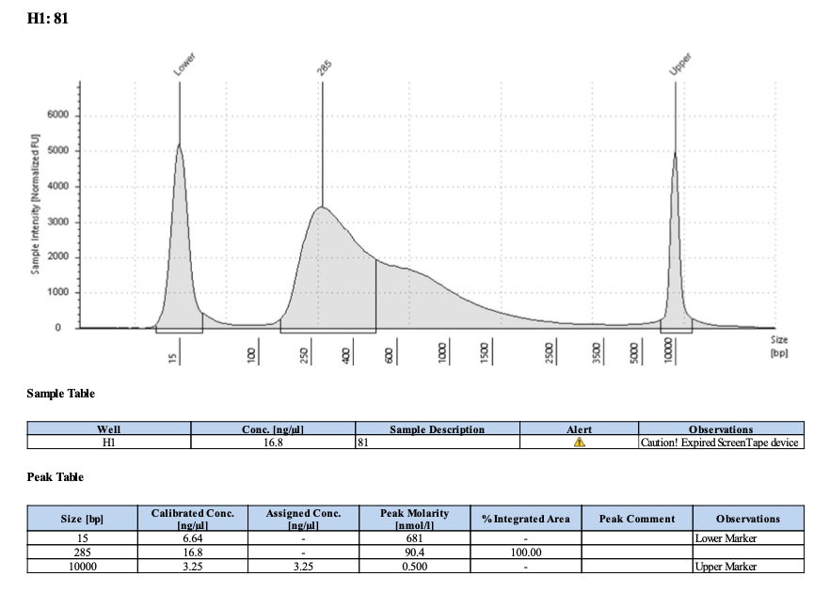
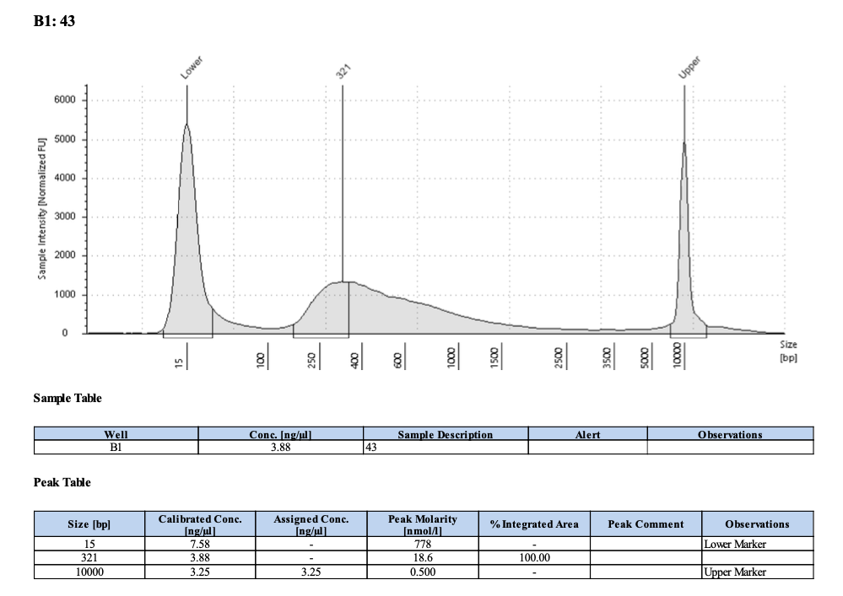
Index #30; Pico #72; 2185
Index #31; Pico #80; 2564
300
268
Index #32; Pico #81; 1757
Index #33; Pico #43; 1416
285
321

Slide 9
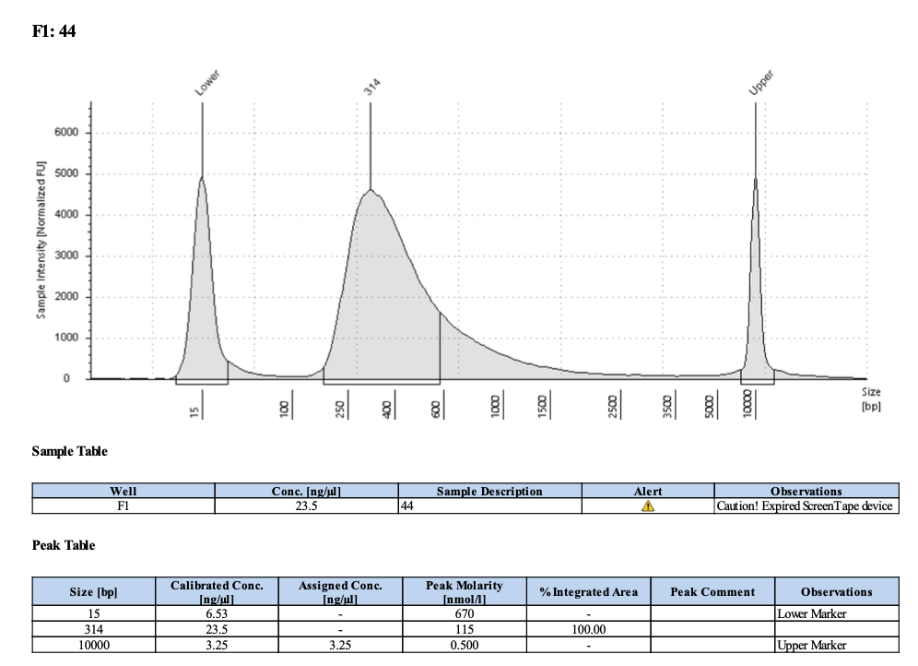
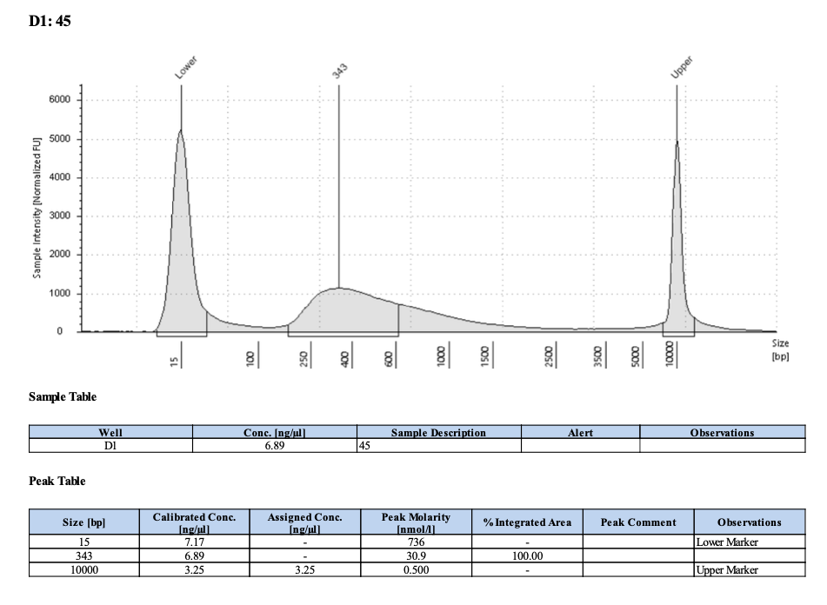
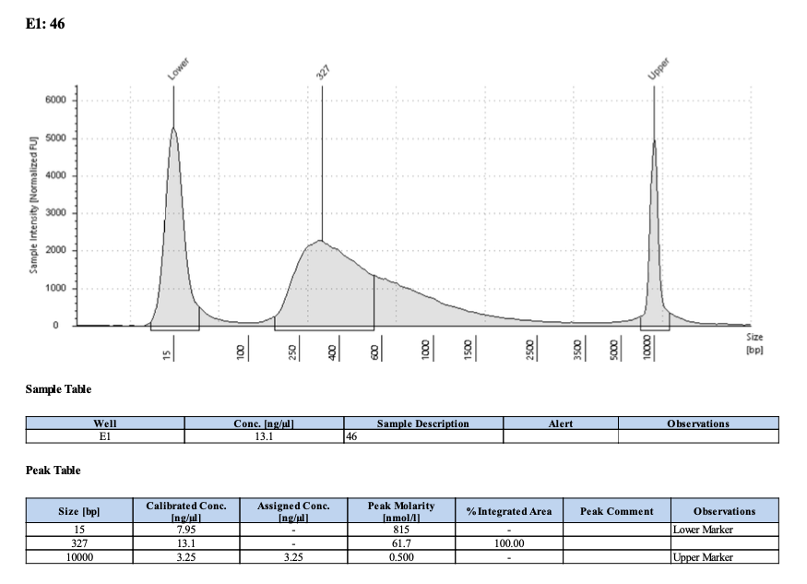
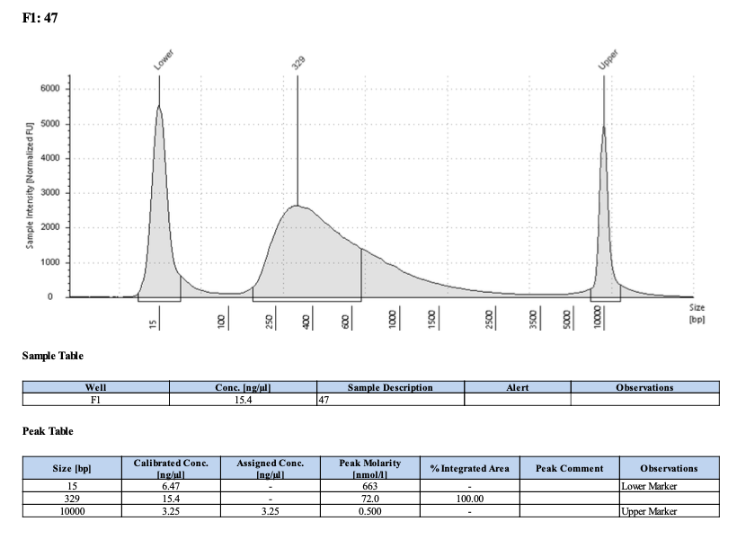
Index #34; Pico #44; 1415
Index #35; Pico #45; 1641
314
343
Index #36; Pico #46; 1536
Index #37; Pico #47; 1090
327
329

Slide 10
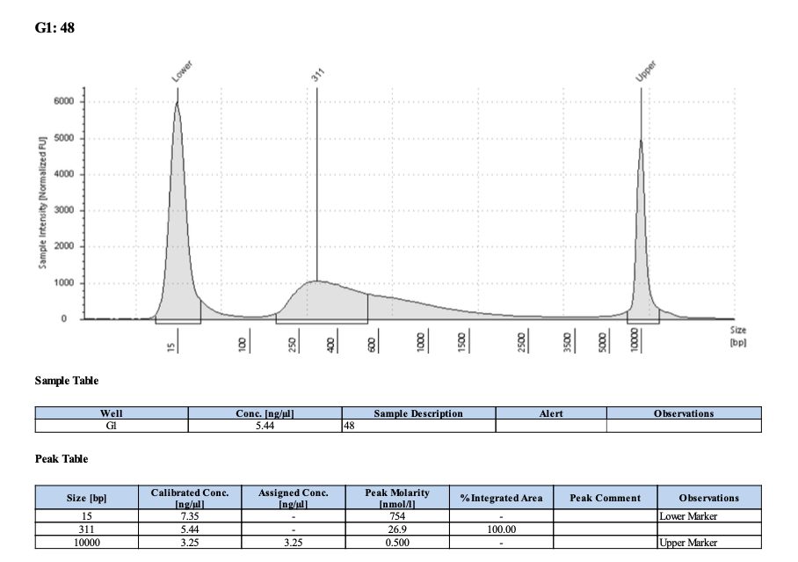
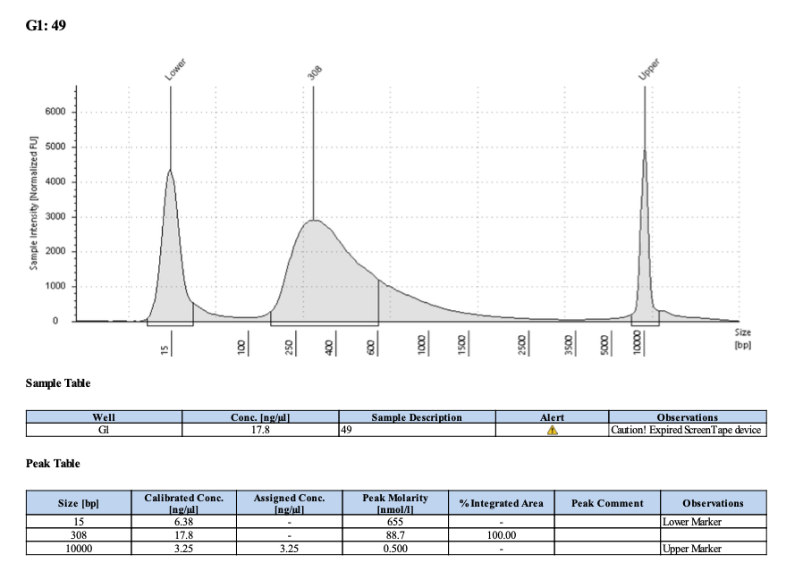
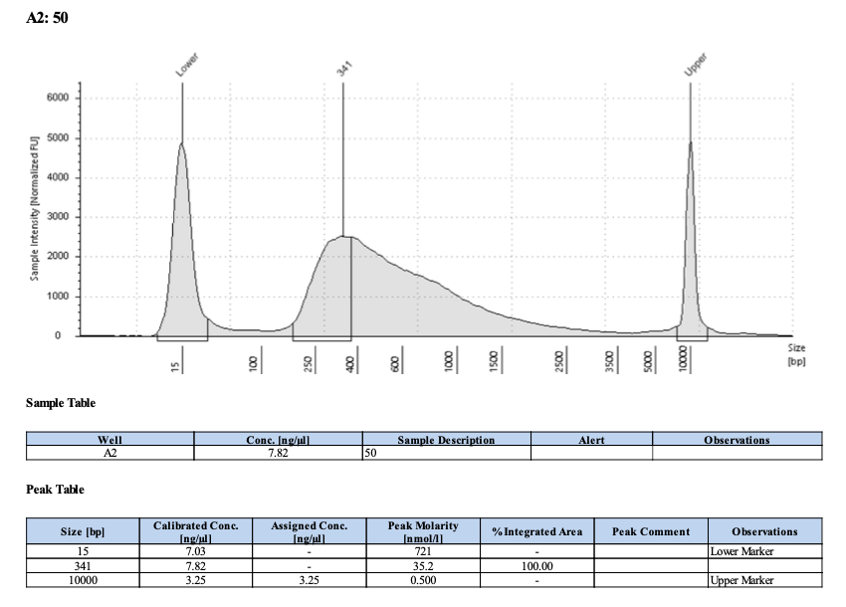
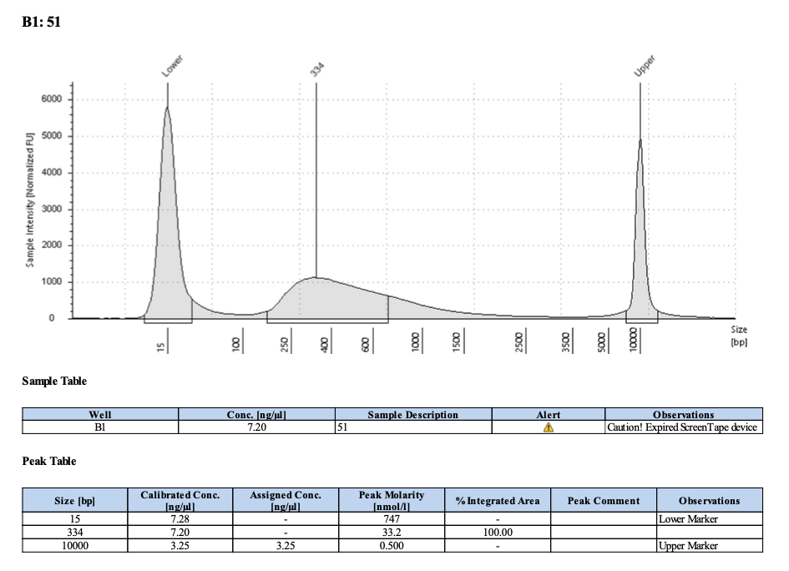
Index #38; Pico #48; 1303
Index #39; Pico #49; 1755
311
308
Index #40; Pico #50; 1596
Index #41; Pico #51; 1281
341
334

Slide 11
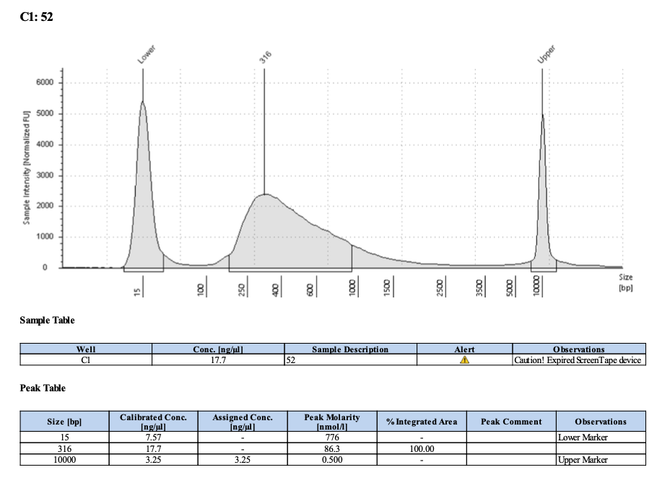
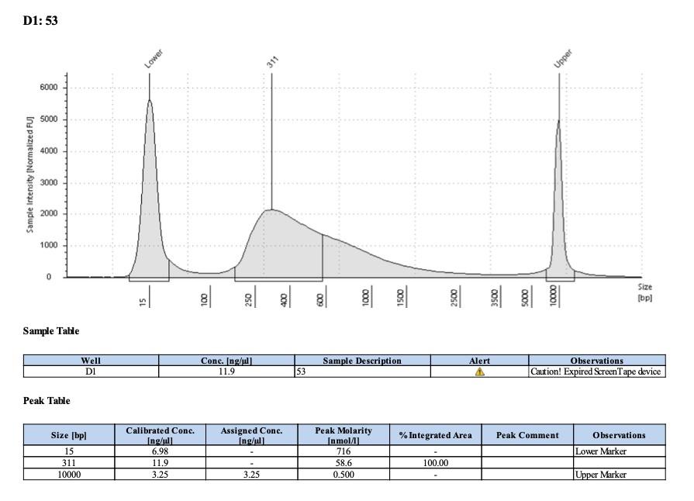
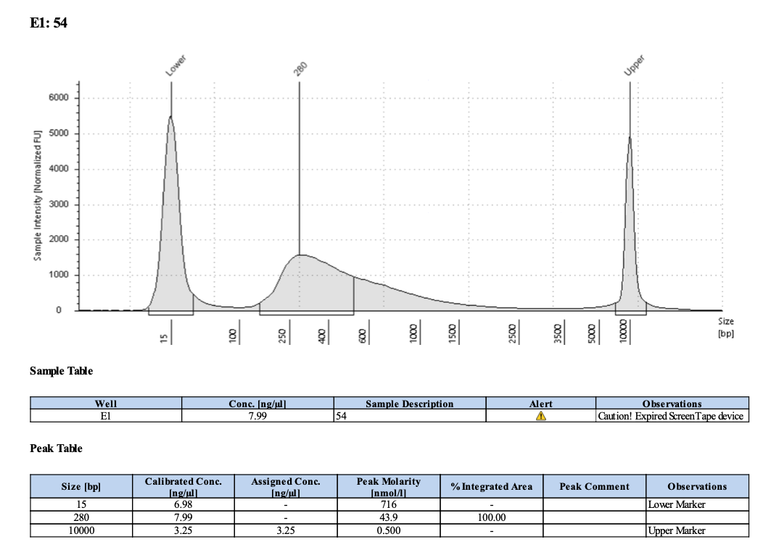
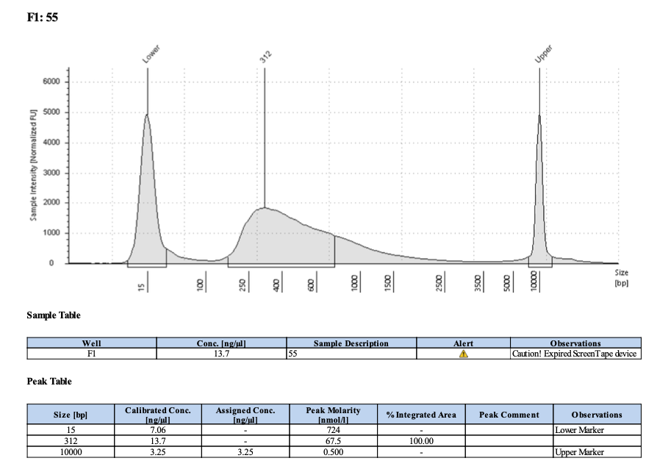
Index #42; Pico #52; 1571
Index #43; Pico #53; 2300
316
311
Index #44; Pico #54; 1427
Index #45; Pico #55; 1205
280
312

Slide 12
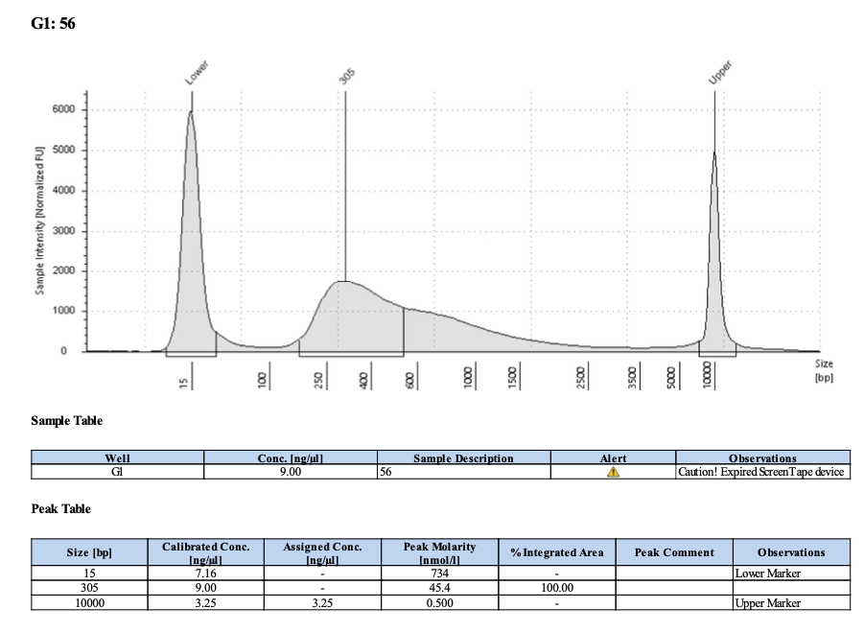
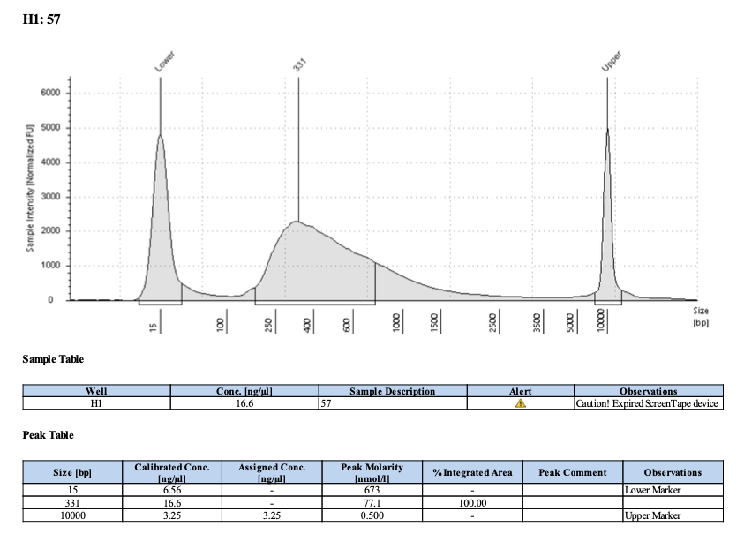
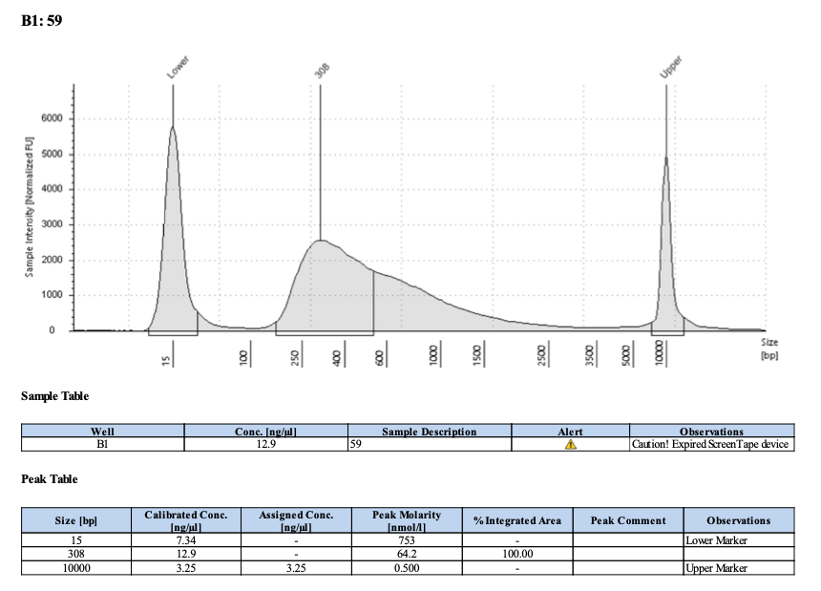
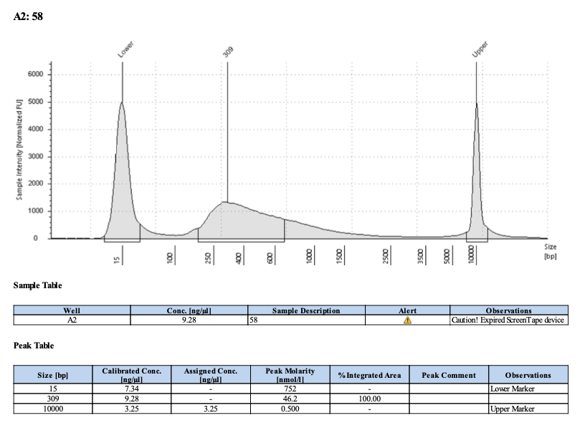
Index #46; Pico #56; 2879
Index #47; Pico #57; 1709
305
331
Index #48; Pico #58; 1777
Index #49; Pico #59; 2306
309
308

Slide 13
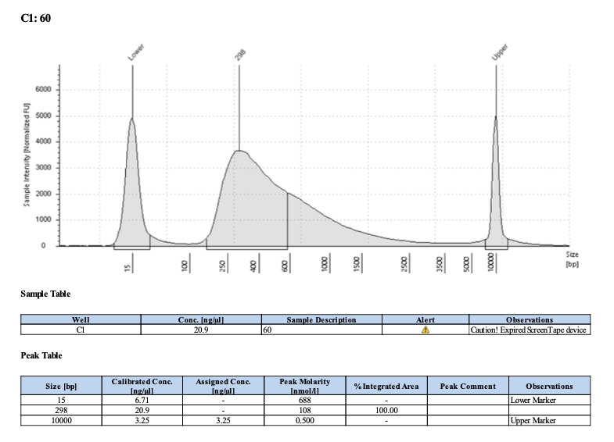
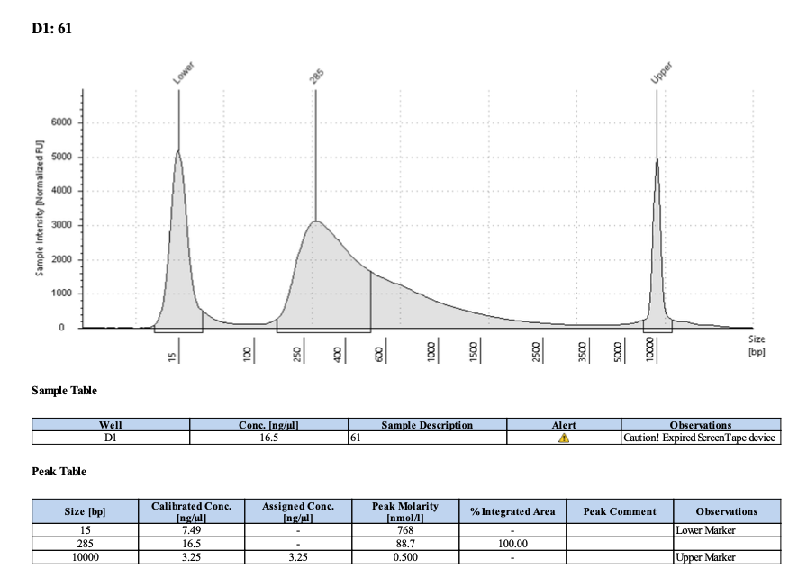
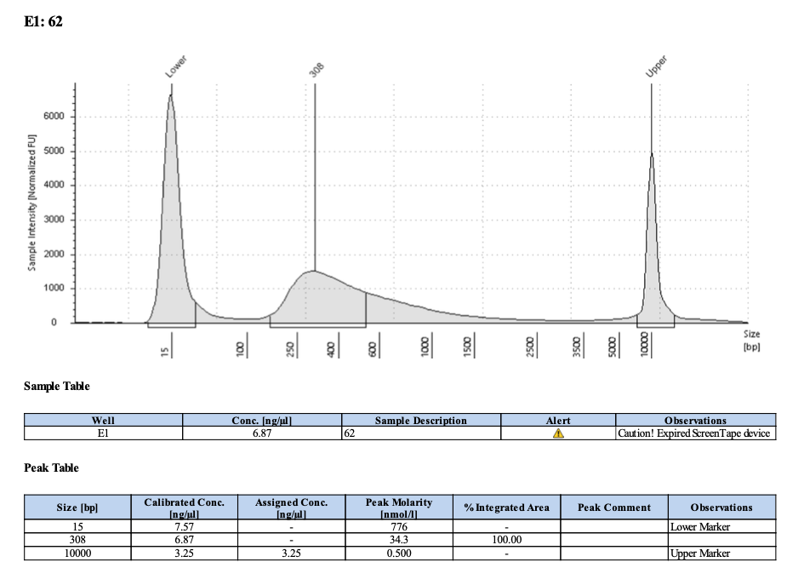
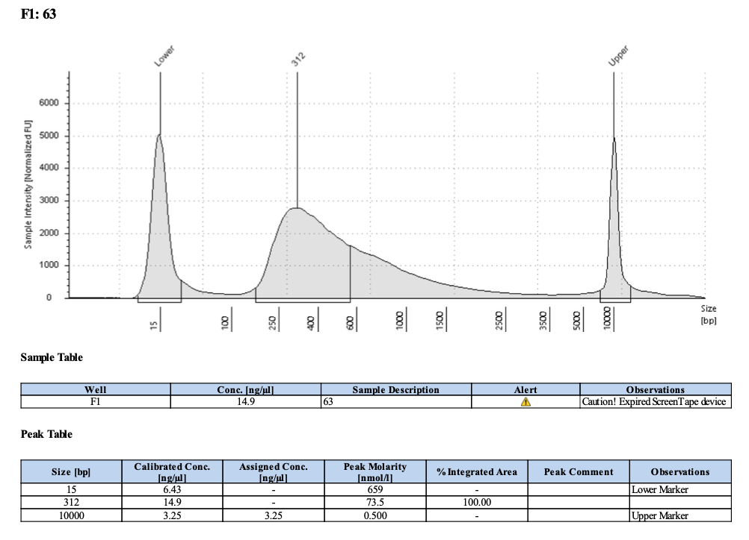
Index #50; Pico #60; 1582
Index #51; Pico #61; 1647
298
285
Index #52; Pico #62; 1159
Index #53; Pico #63; 1487
308
312

Slide 14




Index #54; Pico #64; 2668
Index #55; Pico #75; 1047
291
336
Index #56; Pico #76; 1059
Index #57; Pico #77; 2409
332
334

Slide 15


Index #58; Pico #78; 2087
Index #59; Pico #79; 1147
396
291

